Slide 1
Level 1 Certificate in Skills for Creative Industries
Unit 003 The Creative Industries
Notes:
Link to specification: The Creative Industries - Gateway Qualifications
(https://www.gatewayqualifications.org.uk/unit/126218/)

Slide 2
This Unit
Intent
This unit is designed to is to introduce you to the Creative Industries and the industry sectors. You will explore employment opportunities and the skills and qualifications required to enter this industry.
Implementation
Research different sectors and how they are evolving
Understand organisational structures
Explore different types of employment within sectors
Know how to find employment opportunities
Impact
Upon completion of this unit, you will have a good understanding of the Creative Industries and how to find employment opportunities.
The Creative
Industries
Notes:
Assessment 1
Describe the different sectors within the creative industries. (TCI 1.1)
Q1. Describe two or more different sectors within the creative industries.
Outline the structure of different organisations within the creative industries. (TCI 1.2)
Q2. Outline the structure of two or more different organisations within the creative industries.
Assessment 2
Describe recruitment methods used in the creative industries. (TCI 3.1)
Q1. Describe two or more recruitment methods used in the creative industries.
Identify different types of employment in the creative industries. (TCI 2.1)
Describe job roles in one of the creative industries sectors. (TCI 2.2)
Outline the skills and qualifications required for different job roles within one of the sectors within the creative industries. (TCI 3.2)
Q2. Choose one creative industry sector, and then:
a) describe two or more job roles within it (2.2)
b) outline the skills and qualifications required for them (3.2)
c) identify different types of employment for them (2.1)

Slide 3
This Session
Intent
This unit is designed to is to introduce you to the Creative Industries and the industry sectors. You will explore the structure of different organisations.
Implementation
Research the different sectors
Explore structure of different organisations
Impact
Upon completion of this unit, you will have a better understanding of the sectors within the Creative Industries and the different structures. You will have a good understanding of how technology has changed and continues to change the industry.
The Creative
Industries
Notes:
Assessment 1
Describe the different sectors within the creative industries. (TCI 1.1)
Q1. Describe two or more different sectors within the creative industries.
Outline the structure of different organisations within the creative industries. (TCI 1.2)
Q2. Outline the structure of two or more different organisations within the creative industries.

Slide 4
Starter
What is the Creative Industry?
Can you name the sectors?
Sector: “one of the areas into which economic activity is divided”
Notes:
Can you identify any ‘sectors’ – a sector is groups of industries, based on their commonalities. Those firms that produce similar products or provide similar services using similar business processes.
Has anyone worked in the creative industry?

Slide 5
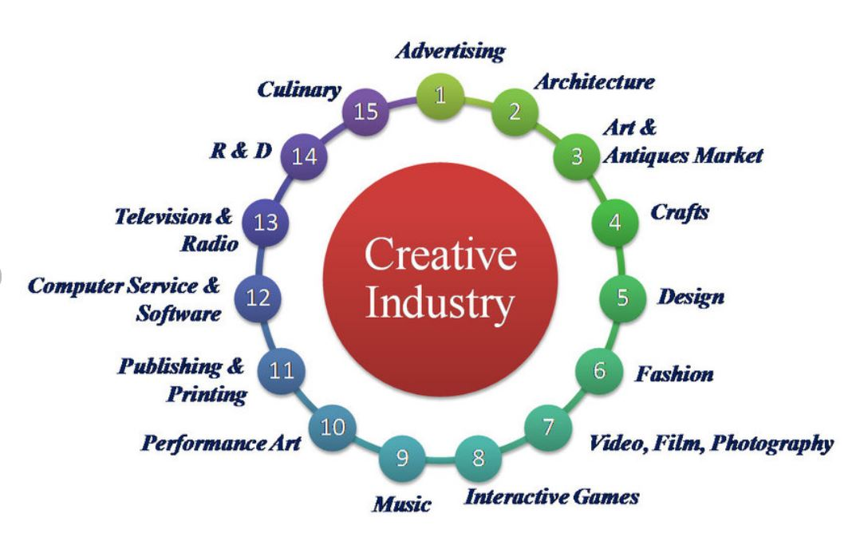
Sectors
Definition from the UK Government’s Department for Culture, Media and Sport (DCMS) is:
‘Those industries which have their origin in individual creativity, skill and talent and which have a potential for wealth and job creation through the generation and exploitation of intellectual property.’
Department for Digital, Culture, Media & Sport - GOV.UK (www.gov.uk)
Notes:
Describe the different sectors within the creative industries. (TCI 1.1)
Q1. Describe two or more different sectors within the creative industries.
The UK government are very interested in this sector because of the huge amount of income the industry generates. They even have their own department which is defined as ‘the department of His Majesty's Government, with responsibility for culture and sport in England, the building of a digital economy, and some aspects of the media throughout the UK, such as broadcasting and the Internet’.
Intellectual property is something that you create using your mind - for example, a story, an invention, an artistic work or a symbol. However there are laws in place to protect these - ?? Which law? Copyright comes under one of the fundamental British Values – can anyone tell me which one?

Slide 6
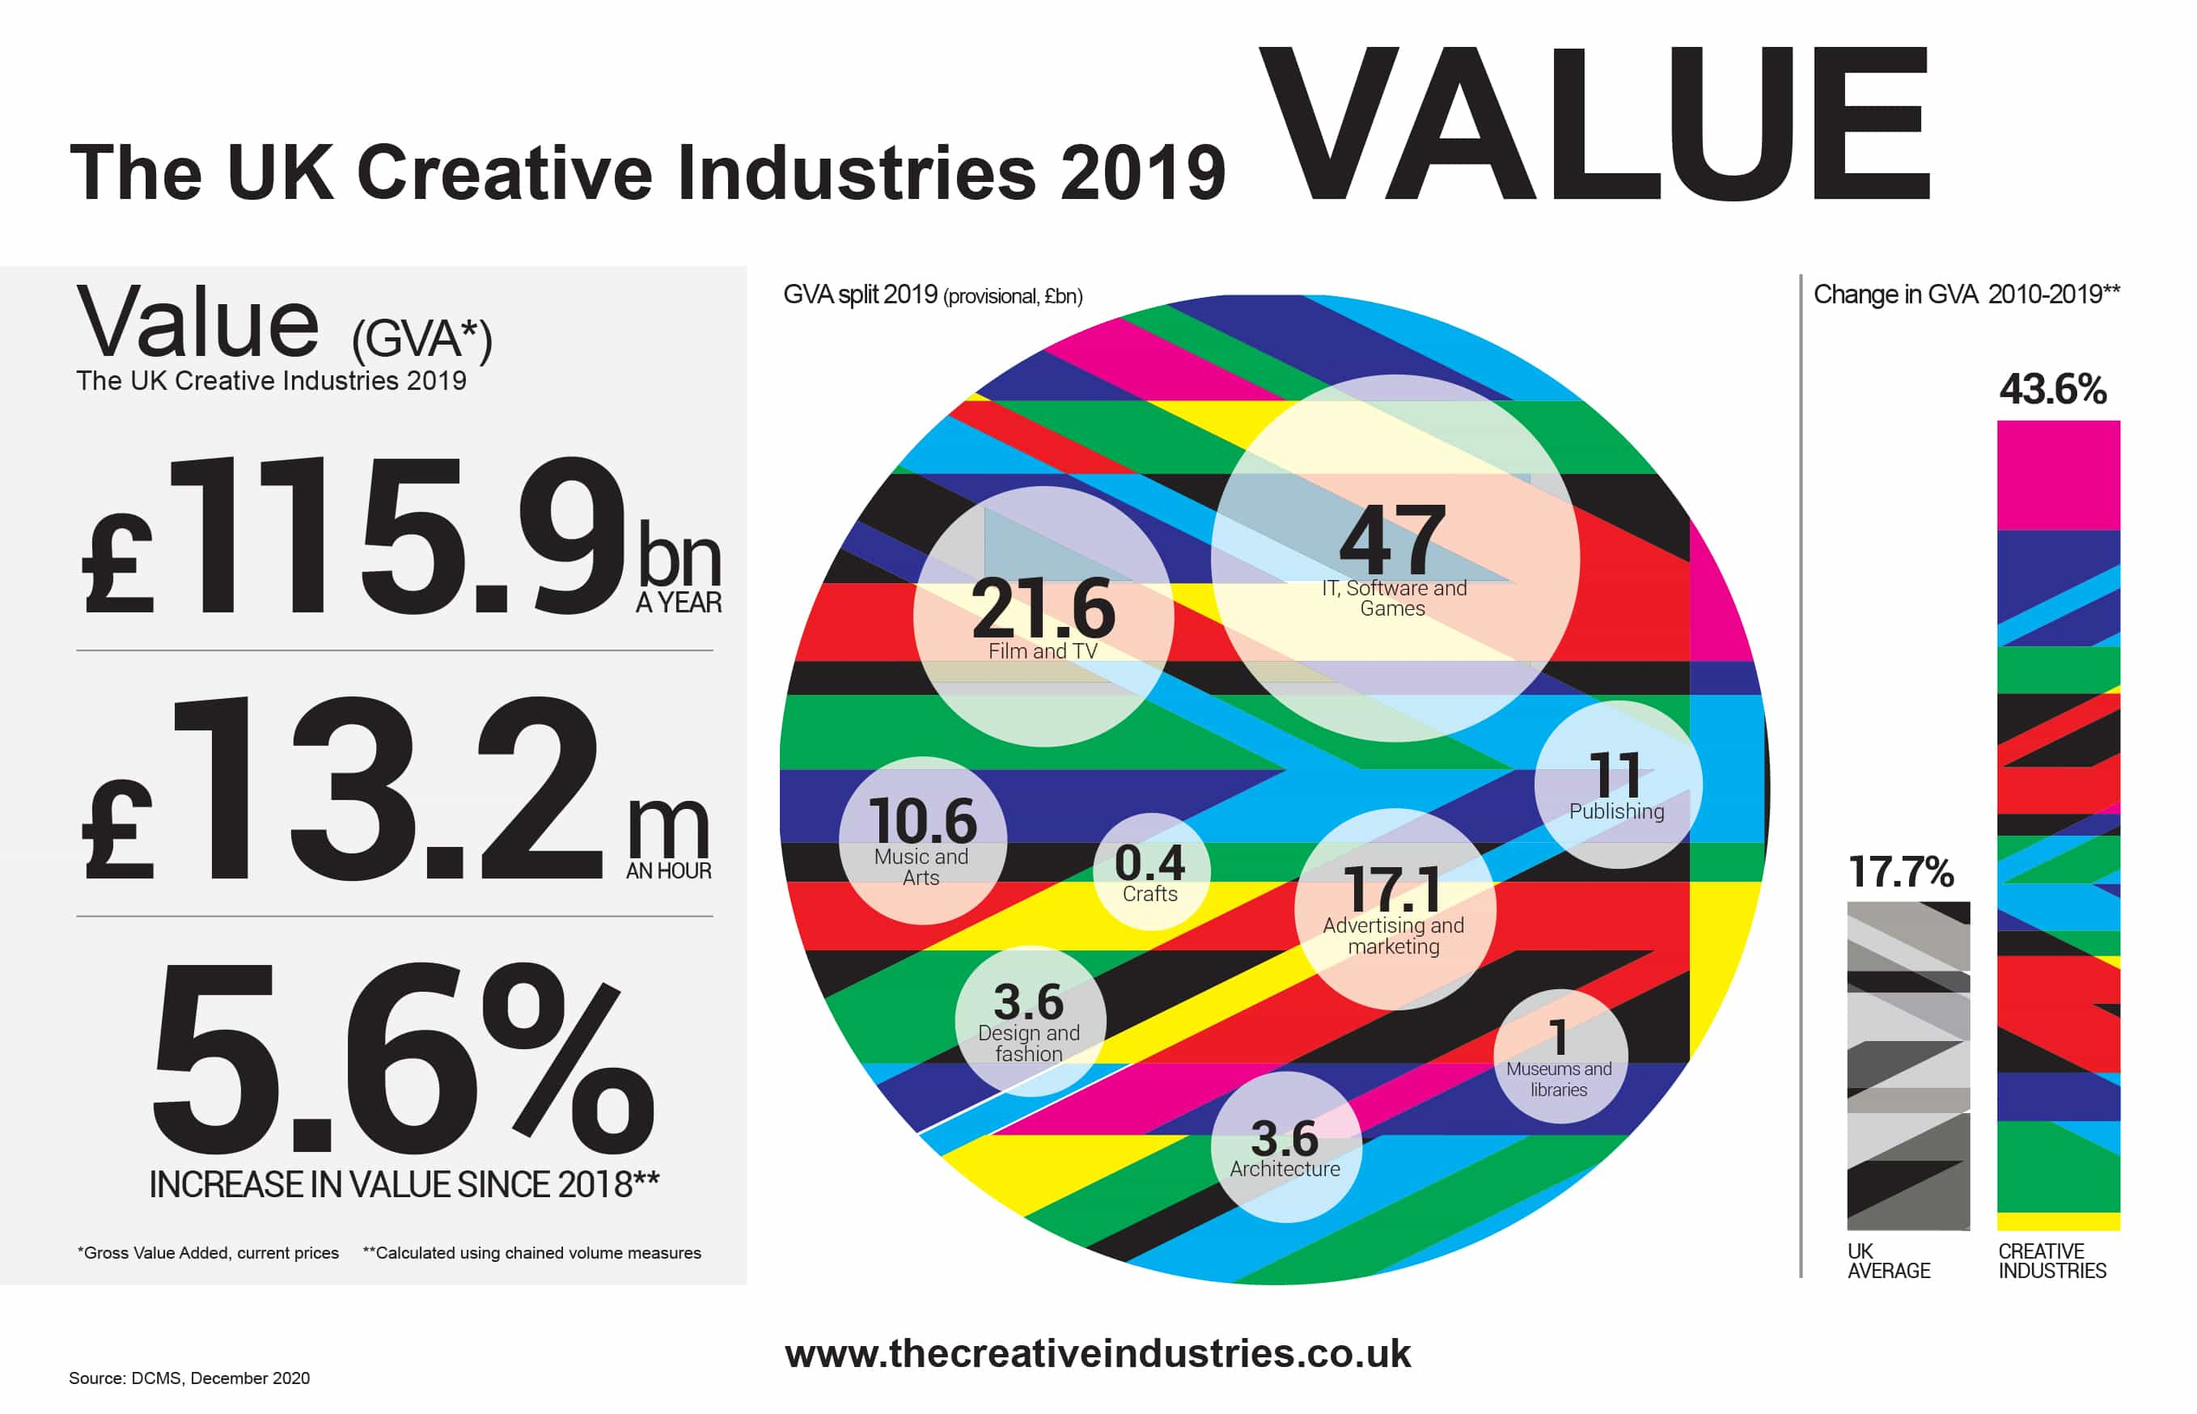
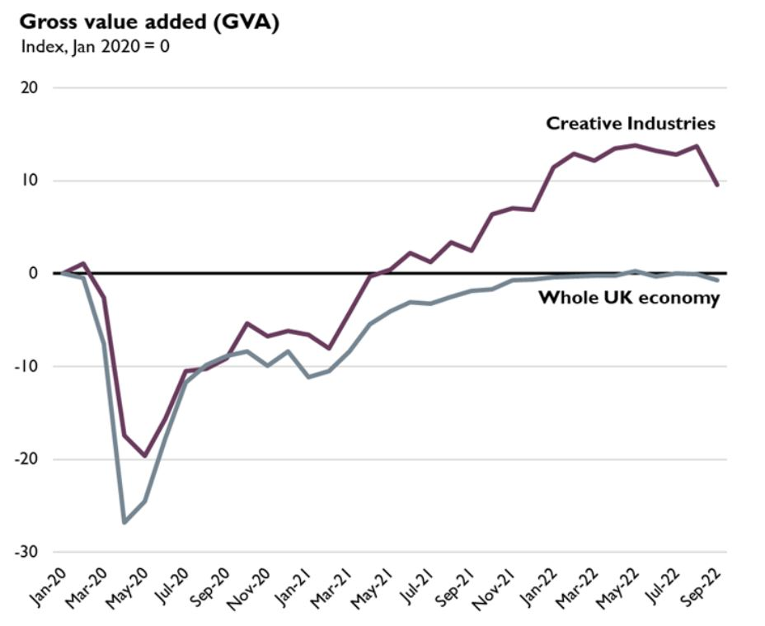
Creative Industry Value to UK Economy
2019
2022
Creative Industries Value
Notes:
The value of the creative industries - as a whole, the creative industries are worth £116 billion to the UK economy, employs over 2.1 million people directly and pre-pandemic were growing at 3 times the national average. The audio-visual sector – film and television – is a key contributor
GVA – Gross value added
KEY STATS –
The creative industries sector contributed £109bn to the UK economy in 2021.
Next key stats will be available sept 2023
UK Consumer Games Market Worth Record £7.16bn In 2021 – this was updated in April 2022
https://www.thecreativeindustries.co.uk/site-content/uk-consumer-games-market-worth-ps7-12bn-in-2021
Source: DCMS – Department for Digital, Culture, Media and Sport
It is an industry that is very undervalued with regards to if you tell your parents that you want to be an artist or create games for instance, you may get a negative response. However, the government are pushing the creative industries as it is the most valuable income the UK has.

Slide 7
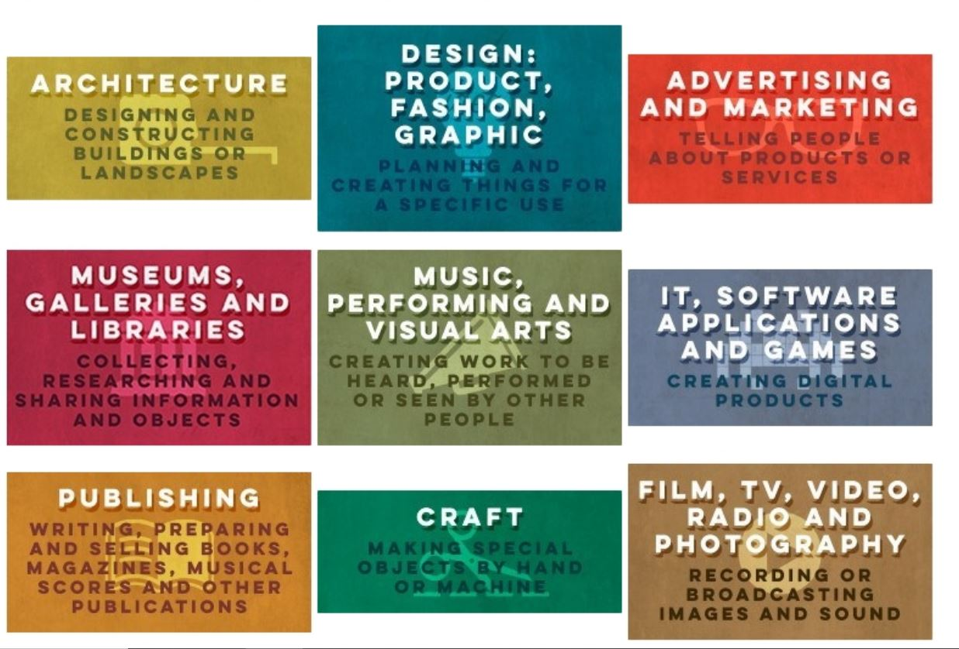
Sectors Within The Creative Industry
Notes:
Describe the different sectors within the creative industries. (TCI 1.1)
Q1. Describe two or more different sectors within the creative industries.
Think about the Music sector – copyright, sound engineers, the artists, agents, labels.
Pose, pause, pounce, bounce. What does the photography sector involve? who is involved? Eg product photographers on websites, wedding photographers.
Who is involved in computer games?
Interactive media eg web design.
Craft – anything with hands, knitting – Etsy. Hand crafts. Visual arts – paintings, not photography unless high end artistic photography, sculptures.
E&D – More females than males study creatives arts subjects, but a smaller proportion of women go into creative jobs - Gov funding– the government are funding the creative skills of the future - via a careers programme that will open up creative jobs to people of every background
Creative industries: Sector Deal - GOV.UK (www.gov.uk) https://www.gov.uk/government/publications/creative-industries-sector-deal
3 teams
Refer to jamboard tutorial - JAMBOARD unit 1 assessment 1 q1/q2 Learners need to research the different sectors and name companies within that sector. 20mins
https://jamboard.google.com/d/1X2bcdDxRQlk_eLGJ3Xn0S8_hNCz2Z3qgNroYIehvxHA/edit?usp=sharing

Slide 8
Break Out Room
20 minutes
Research the different sectors and identify companies within that sector.
Mutual Respect & Tolerance
Mutual respect is the foundation for honesty and truth and meaningful communication.
Britain is a multi-cultural country, and many different faiths and beliefs are celebrated here.
In Britain we pride ourselves on living in peace with one another.
Individual Liberty
Individual Liberty is being free from oppressive restrictions that we work hard to protect.
It is important to remember the sacrifice people have made to preserve our individual liberty, such as WW1 & WW2.
We have the freedom to choose how we live our lives.
The Rule of Law
All people and institutions are subject to and accountable to law that is fairly applied and enforced, no one is above the law.
Democracy
Democracy means that we have a say in what happens.
Click here to go to Jamboard
Notes:
Describe the different sectors within the creative industries. (TCI 1.1)
Q1. Describe two or more different sectors within the creative industries.
Learners need to research the different sectors and name companies within that sector. 20mins
Discuss findings
What company is associated with the TV sector
What other companies in any other sectors?

Slide 9
Digitisation of the Creative Industries
noun: digitisation
the conversion of text, pictures, or sound into a digital form that can be processed by a computer.
"the digitisation of the rare map collection at the library"
adaptation of a system, process, etc. to be operated with the use of computers and the internet.
"as digitisation continues, data will become more valuable than ever before"
Notes:
Creative industries have been mostly influenced by the advancements of specific technologies including Augmented & Virtual Reality (AR/VR), Artificial Intelligence (AI), Cloud and Blockchain technologies
Digitalisation has transformed the processes of the creation, production, distribution and the consumption of content. Culture is increasingly accessed through dedicated platforms, applications, social media and aggregators.
Television
Print
Advertising
Radio
Film
Radio
Crafts
Visual arts
Interactive media
Computer games

Slide 10
Break Out Room
10 minutes
Research digitisation of different sectors
Mutual Respect & Tolerance
Mutual respect is the foundation for honesty and truth and meaningful communication.
Britain is a multi-cultural country,and many different faiths and beliefs are celebrated here.
In Britain we pride ourselves on living in peace with one another.
Individual Liberty
Individual Liberty is being free from oppressive restrictions that we work hard to protect.
It is important to remember the sacrifice people have made to preserve our individual liberty, such as WW1 & WW2.
We have the freedom to choose how we live our lives.
The Rule of Law
All people and institutions are subject to and accountable to law that is fairly applied and enforced, no one is above the law.
Democracy
Democracy means that we have a say in what happens.
Click here to go to Jamboard
Notes:
Describe the different sectors within the creative industries. (TCI 1.1)
Q1. Describe two or more different sectors within the creative industries.
Return to same jamboard 10 minutes to research 2 sectors and discuss digitisation discuss digitisation and give examples where it is used in each sector.

Slide 11
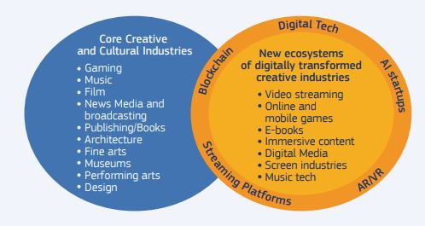
Digitisation
Notes:
Discuss findings

Slide 12
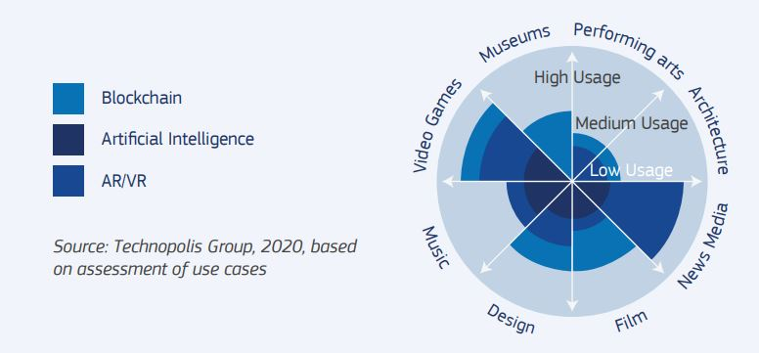
Digitisation
Ai-da
Bing AI create
Notes:
Source: Leaflet Technological trends in the creative industries.pdf (europa.eu)
https://ati.ec.europa.eu/sites/default/files/2021-10/Leaflet%20Technological%20trends%20in%20the%20creative%20industries.pdf
Technological convergence, also known as digital convergence, is for technologies that were originally unrelated to become more closely integrated and even unified as they develop and advance. For example, watches, telephones, television, computers, and social media platforms began as separate and mostly unrelated technologies, but have converged in many ways into interrelated telecommunication, media, and technology industry.
Music & blockchain – Blockchain music is the use of blockchain technology to attach extended digital content, ownership and rights of information, and smart contracts to songs. Allows artists to showcase their talents without major labels, equal royalty payments, counterfeit tickets, fair and transparent system for the creation, purchase, sale, listening to and management of music.
Quote: ‘Imagine you went to your ATM and tried to take out £60. The machine makes you wait for a half hour then spits out £40 and no receipt. You don’t know where the extra money went, why it took so long or what’s left in your account. For most people, this would be unacceptable. If you’re an artist in today’s music industry, it might be your everyday reality’.

Slide 13
Structure of Organisations Within the Creative Industries
Notes:
Outline the structure of different organisations within the creative industries. (TCI 1.2)
Q2. Outline the structure of two or more different organisations within the creative industries.
What do I mean about organisational structures?
What do you think I mean by ‘the structures of an organisation’?
Pose: Hierarchy – directors, manager, pyramid, layout of company.

Slide 14
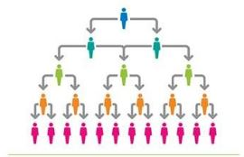
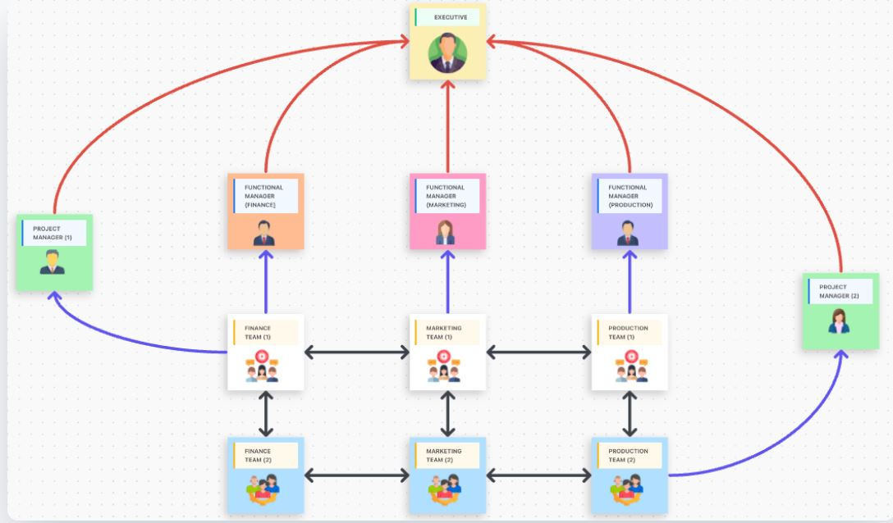
Organisational Structure
Can you define any of the following words?
Flat
Matrix
Functional
Pod
Holacracy
Notes:
Outline the structure of different organisations within the creative industries. (TCI 1.2)
Q2. Outline the structure of two or more different organisations within the creative industries.
Flat – functional – matrix – holacracy – pods

Slide 15
Break Out Room
10 minutes
Research organisational structure
Mutual Respect & Tolerance
Mutual respect is the foundation for honesty and truth and meaningful communication.
Britain is a multi-cultural country, and many different faiths and beliefs are celebrated here.
In Britain we pride ourselves on living in peace with one another.
Individual Liberty
Individual Liberty is being free from oppressive restrictions that we work hard to protect.
It is important to remember the sacrifice people have made to preserve our individual liberty, such as WW1 & WW2.
We have the freedom to choose how we live our lives.
The Rule of Law
All people and institutions are subject to and accountable to law that is fairly applied and enforced, no one is above the law.
Democracy
Democracy means that we have a say in what happens.
Click here to go to Jamboard
Notes:
Outline the structure of different organisations within the creative industries. (TCI 1.2)
Q2. Outline the structure of two or more different organisations within the creative industries.
Jamboard 10 minutes to research organisational structures.

Slide 16
Nearpod Activity
You have 5 minutes to complete quiz
Click here to join the quiz
Notes:
Flat organisational structure is an organisational model with relatively few or no levels of middle management between the executives and the frontline employees. Its goal is to have as little hierarchy as possible.
A functional organizational structure is a team structure that groups employees into different departments based on areas of expertise. This type of structure is one of the most common types in business, especially in larger companies, where groups of employees are organized according to the function they perform.
Holacracy is a governance structure characterized by a distribution of power among self-organizing groups, rather than the top-down authority in the typical hierarchical corporate culture model. Holacracy is a system a system of self-management where leadership roles are not subject to a traditional hierarchy of command. Instead of having a static job description, individuals in a holacracy assume multiple roles, each associated with a purpose, domain, and accountabilities.
Pods- Pods are comprised of a small group of individuals with complementary skills (from full-stacks to QA). Pod members are clustered together around a shared purpose. Each pod is responsible for a certain aspect of the product. They own all tasks involved, from development to performance to bugs.

Slide 17
Structure of Organisations
Geographical
Scope
Size
Local
Regional
National
International
Structure
Small/ Medium/Large
Sole Traders/ External
Public
Private
Cross Sector
Company Size Table
Companies Act 2006 (legislation.gov.uk)
Notes:
Outline the structure of different organisations within the creative industries. (TCI 1.2)
Q2. Outline the structure of two or more different organisations within the creative industries.
We are going to look at the geographical scope, is the company local or international. The size is it a small company or is it sole trader or external – for example – an external company is where you would use another company to do the things you as a company don’t do – it could be printing for example. Then the structure is it public, private or cross sector – a cross between the two. Cross sector companies are a cross between public, private, and/or non-profit institutions in which individuals from partner organizations commit various resources and agree to work cooperatively toward common development goals. Zara is a good example. Think photographer.
Choose two organisations within the creative industries Eg Rockstar games, Geographical scope is international which is based in New York. Consider taking a screenshot of the logo and add. Reduce size of image.
Size Link shows a table to determine company size. UK figures, if US company then figures will be larger.
https://www.informdirect.co.uk/company-records/limited-company-accounts-types-details/#:~:text=Company%20size%20thresholds%20The%20Companies%20Act%202006%20prescribes,as%20very%20small%20%28a%20micro-entity%29%2C%20small%20or%20medium.
Micro Business = less than 10 employees & turnover under £2 million
Small Business = less than 50 employees & turnover under £10 million
Medium Business = Less than 250 employees & turnover under £50 million
Anything over that doesn’t meet the criteria is considered a large company
External is contract – sole trader is usually a shorter contract. External companies provide services – think photographer or sole trader.
Structure:
What is a public company?
Public limited companies (PLCs) are similar to private limited companies. However, shares in a public company can be freely sold and traded to the general public and their shares can be listed on a stock exchange. PLCs are the only type of company allowed to raise capital from this type of public investment.
What is a private company?
Most companies in the UK are private limited companies (LTDs). The personal finances of any shareholders (ie company owners) are protected by limited liability (ie their liabilities are limited to the value of their shares). Shares in private companies cannot be offered to the general public.
(Source: https://www.rocketlawyer.com/gb/en/quick-guides/what-are-the-differences-between-plcs-and-ltds)
So if Private they are in control of own assets. Public is when you have shares and they have to answer to shareholders who have a say in the company.
Aardman is interesting, it’s employee owned. https://www.aardman.com/about/
https://www.linkedin.com/company/aardman/?originalSubdomain=uk
Aardman offer training https://academy.aardman.com/
Zara is very interesting and has it’s own structure. Zara have shares but limits to what they can control. Other industries are rolling it out. Cross sector – mix of public & private
Why are we doing this? Why do we need to know – to have an understanding because of wanting a job in the sector. Being aware of organisational structures within the sectors. They’re a different
Understand the sector, the job role and the legalities in this industry.
Research sectors or companies in LinkedIn – Netflix, Zara

Slide 18
Business – LTD or PLC
Different types of companies
Difference between
PLC and LTD - Public vs private
Get information about a company
Notes:
Outline the structure of different organisations within the creative industries. (TCI 1.2)
Q2. Outline the structure of two or more different organisations within the creative industries.
Watch video 5mins: https://www.youtube.com/watch?v=OFIuIiml1q0
https://www.gov.uk/get-information-about-a-company
https://www.rocketlawyer.com/gb/en/quick-guides/what-are-the-differences-between-plcs-and-ltds

Slide 19
Did we achieve?
Intent
This unit is designed to is to introduce you to the Creative Industries and the industry sectors. You will explore the structure of different organisations.
Implementation
Research the different sectors
Explore structure of different organisations
Impact
Upon completion of this unit, you will have a better understanding of the sectors within the Creative Industries and the different structures. You will have a good understanding of how technology has changed and continues to change the industry.
The Creative
Industries
Notes:
Assessment 1
Describe the different sectors within the creative industries. (TCI 1.1)
Q1. Describe two or more different sectors within the creative industries.
Outline the structure of different organisations within the creative industries. (TCI 1.2)
Q2. Outline the structure of two or more different organisations within the creative industries.

Slide 20
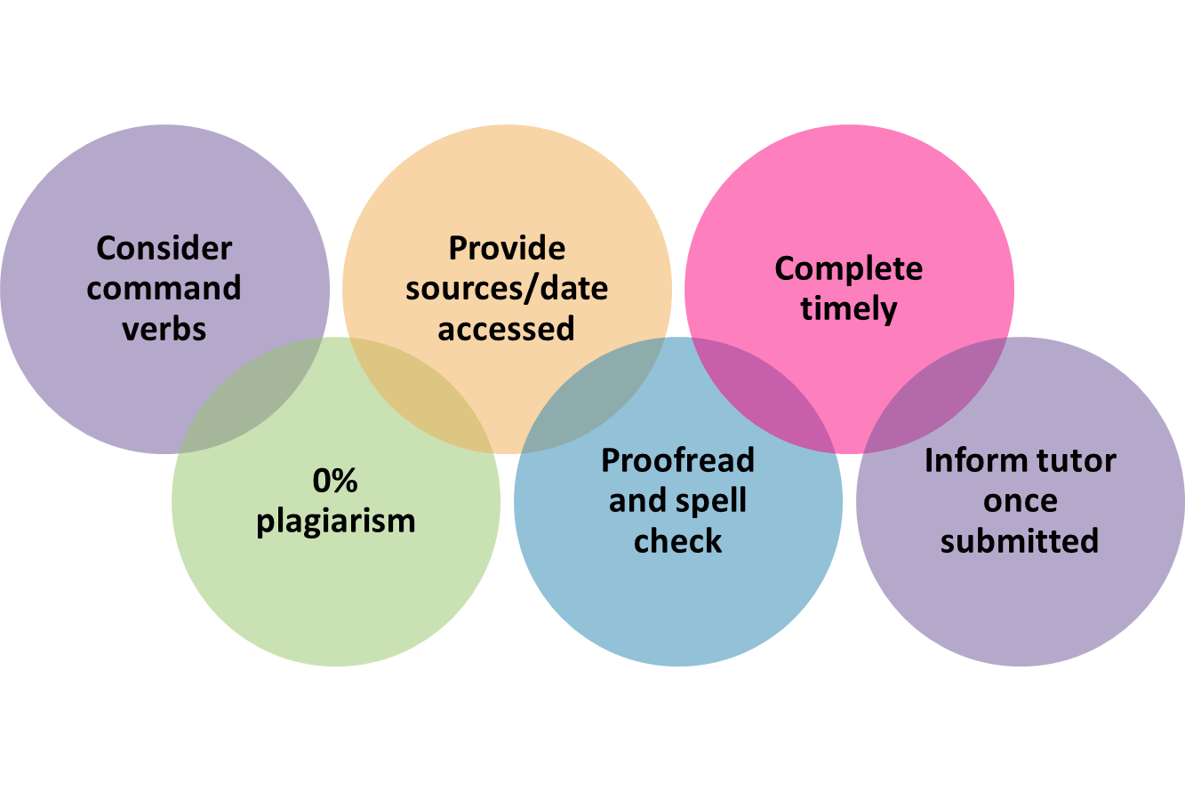
Assessment Activity
Unit 003 The Creative Industries
Assessment 1
Notes:
Think about what we have discussed – what will be your focus for today? What do you want to achieve?
Assessment 1
Describe the different sectors within the creative industries. (TCI 1.1)
Q1. Describe two or more different sectors within the creative industries.
Outline the structure of different organisations within the creative industries. (TCI 1.2)
Q2. Outline the structure of two or more different organisations within the creative industries.
20

Slide 21
Unit 003 The Creative Industries Assessment 2
Level 1 Certificate in Skills for Creative Industries
Notes:
Assessment 2
Describe recruitment methods used in the creative industries. (TCI 3.1)
Q1. Describe two or more recruitment methods used in the creative industries.
Identify different types of employment in the creative industries. (TCI 2.1)
Describe job roles in one of the creative industries sectors. (TCI 2.2)
Outline the skills and qualifications required for different job roles within one of the sectors within the creative industries. (TCI 3.2)
Q2. Choose one creative industry sector, and then:
a) describe two or more job roles within it (2.2)
b) outline the skills and qualifications required for them (3.2)
c) identify different types of employment for them (2.1)
21

Slide 22
This Session
Intent
The purpose of this session is to develop your knowledge about recruitment methods and job opportunities within the creative industries and to discover training and recruitment opportunities.
Implementation
Research different recruitment methods
Explore different types of employment
Understand the role of Sector Skills Councils
Explore training and job opportunities
Impact
Upon completion of this unit, you will have a better understanding of different job roles and employment opportunities in the Creative Industries; where to find them, and organisations that provide training and support for each sector.
The Creative
Industries
Notes:
Assessment 2
Describe recruitment methods used in the creative industries. (TCI 3.1)
Q1. Describe two or more recruitment methods used in the creative industries.
Identify different types of employment in the creative industries. (TCI 2.1)
Describe job roles in one of the creative industries sectors. (TCI 2.2)
Outline the skills and qualifications required for different job roles within one of the sectors within the creative industries. (TCI 3.2)
Q2. Choose one creative industry sector, and then:
a) describe two or more job roles within it (2.2)
b) outline the skills and qualifications required for them (3.2)
c) identify different types of employment for them (2.1)

Slide 23
Job Roles In the Creative Industries
Notes:
We are going to be looking at some of the job roles in the creative industries in a bit more detail

Slide 24
Starter
Who Am !?
1. Every day is different really. At the beginning of the job, I start by researching all the stories I've been given. I read the script two or three times and make notes, and then I start looking for reference pictures to make mood boards to illustrate the costumes that I want to represent for each character. I'll also have shopping days where I'm looking for clothes.
2. Conducting research to uncover interesting and significant news. Gathering, corroborating and interpreting data. Interviewing key persons (witnesses, sources etc.) to obtain more information. Researching and writing informational news articles and stories about real events using a fair and unbiased perspective. Interviewing experts, gathering first-hand accounts of events and organizing an outline into a cohesive, interesting story.
3. The typical day of a _______ is very interesting. _____ get to do a number of activities during their work. Quite frequently they have to travel as well. The day generally starts with the meetings and deciding the course of the day. They have to work with great precision. They have to be extremely focused . The job often requires travel to the clients' sites, and they have to reach there on time. It's important that they are good with people skills as they have to communicate with a number of people.
4. The client has given us a comprehensive brief and has included all of the copy and photos needed to complete the job. I draft out a couple of rough design layouts and email the client with my initial draft design ideas. A quick exchange of emails follows, and we have a consensus on which design works best. I bury my head in Adobe InDesign and Adobe Photoshop.
Notes:
Has anyone worked in the creative industry?
1 Costume designer
2 Journalist
3 Photographer
4 Graphic designer

Slide 25
Introduction to Creative Industries
Watch the video and identify roles in the creative industry
Notes:
Identify different types of employment in the creative industries. (TCI 2.1)
Q2. c) identify different types of employment for them (2.1)
Learners will watch the video and identify different jobs of employment in creative industries.
There are lots of opportunities now that a lot of offices have moved to remote working.
Live events, marketing
Roles mentioned in the video:
Graphic Designer
Merchandiser
Window Dresser
Web Design & Development
Artist
Dancer
Musician
Theatre
Architect
Tech (variety of roles) Producer, Engineer
Project Manager

Slide 26
Employment Opportunities in the Creative Industries
Careers in the media and creative sector - BBC Bitesize
Notes:
Identify different types of employment in the creative industries. (TCI 2.1)
Describe job roles in one of the creative industries sectors. (TCI 2.2)
Q2. Choose one creative industry sector, and then:
a) describe two or more job roles within it (2.2)
c) identify different types of employment for them (2.1)

Slide 27
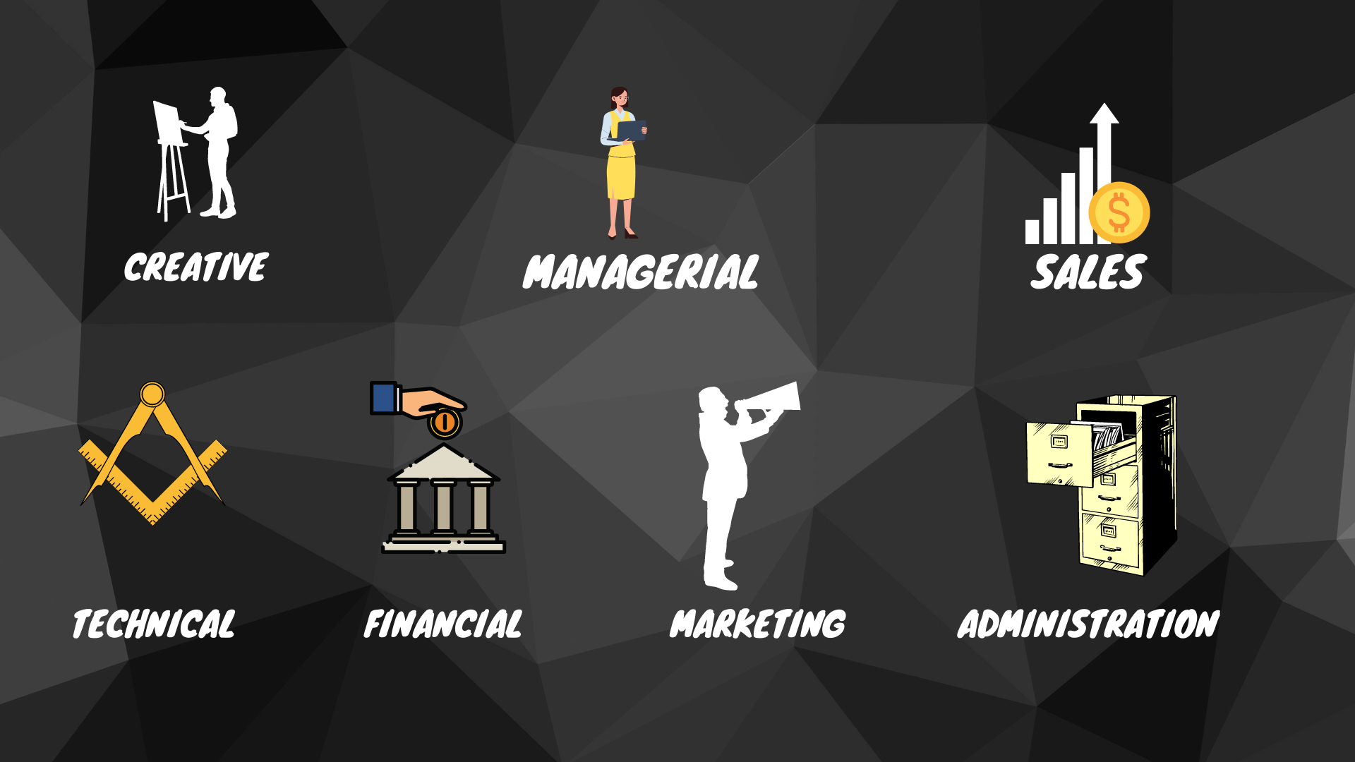
Careers Services
Jobs Board
Notes:
Identify different types of employment in the creative industries. (TCI 2.1)
Outline the skills and qualifications required for different job roles within one of the sectors within the creative industries. (TCI 3.2)
Q2. Choose one creative industry sector, and then:
b) outline the skills and qualifications required for them (3.2)
c) identify different types of employment for them (2.1)
Discover
https://discovercreative.careers/#/
National Careers Service
https://nationalcareers.service.gov.uk/job-categories/creative-and-media
Prospects
https://www.prospects.ac.uk/jobs-and-work-experience/job-sectors/creative-arts-and-design/creative-jobs
Target Careers
https://targetcareers.co.uk/careers-advice/choosing-your-career/313433-i-want-a-creative-career-what-are-my-options
Creativepool
https://creativepool.com/jobs/
So we looked at the multiple sectors in the creative industries and of course we have the creative side, such as authors, video makers, hobbies & crafts, photos for example.
But, in addition, they have to be managed. There’s going to be sales, technical aspects, financial aspects – like investments, viability, marketing etc to reach the right customer, and administration.
So, if you have transferable skills, this could be a way into the sector.

Slide 28
Break Out Room
20 minutes
Identify job roles within a sector
Mutual Respect & Tolerance
Mutual respect is the foundation for honesty and truth and meaningful communication.
Britain is a multi-cultural country, and many different faiths and beliefs are celebrated here.
In Britain we pride ourselves on living in peace with one another.
Individual Liberty
Individual Liberty is being free from oppressive restrictions that we work hard to protect.
It is important to remember the sacrifice people have made to preserve our individual liberty, such as WW1 & WW2.
We have the freedom to choose how we live our lives.
The Rule of Law
All people and institutions are subject to and accountable to law that is fairly applied and enforced, no one is above the law.
Democracy
Democracy means that we have a say in what happens.
Click here to go to Jamboard
Notes:
Describe job roles in one of the creative industries sectors. (TCI 2.2)
Q2. Choose one creative industry sector, and then:
a) describe two or more job roles within it (2.2)
JOBS IDENTIFIED – 20 minutes Identify job roles within sectors

Slide 29
Creative Industries Council
Sector Skills Council
“The Creative Industries Council (CIC) is a forum of government, creative businesses and other creative organisations.
It focuses on areas where there are barriers to growth of UK creative sectors such as access to finance, skills, export markets, regulation, intellectual property (IP) and infrastructure, and on promoting opportunities such as the CreaTech category and greater diversity and inclusion.
Action is taken forward by means of a small number of working groups and initiatives. In 2018, the CIC also set up the Creative Industries Trade & Investment Board (CITIB) to spearhead efforts on exports and inward investment.”
Partners and collaborators
Gov UK & Creative Industries Council
Notes:
Identify different types of employment in the creative industries. (TCI 2.1)
Describe job roles in one of the creative industries sectors. (TCI 2.2)
Outline the skills and qualifications required for different job roles within one of the sectors within the creative industries. (TCI 3.2)
Q2. Choose one creative industry sector, and then:
a) describe two or more job roles within it (2.2)
b) outline the skills and qualifications required for them (3.2)
c) identify different types of employment for them (2.1)
We have supporting organisations that look to upskill people and make the entertainment industry a better place to work.
Show - https://www.thecreativeindustries.co.uk/partners
CIC this website shows supporting skills councils that are associated with creative industries. It’s about having a standard to follow in the industry, you might get certification for it, for example think of editing. You might need to ensure someone is competent or skilled enough, if they are not, then these organisations can support and show how you can upskill. Google - support organisations creative industries.
awareness of the CoSTAR programme, run by the AHRC and UKRI, which plans to invest an estimated £75.6m over six years supporting innovative uses of convergent technologies in screen-based industries.
(Technological convergence, also known as digital convergence, is for technologies that were originally unrelated - as discussed in slide re digitisation. )
https://www.thecreativeindustries.co.uk/
The Creative Industries Council is a joint forum between the creative industries and government. – set up to be a voice for the creative industries.
https://www.gov.uk/government/groups/creative-industries-council
CREATECH
The fast-growing area where creativity interacts with emerging technologies.
Recently, (Oct 2022) The Arts and Humanities Research Council (AHRC) held a briefing in Pontefract to increase

Slide 30
Sector Skills Councils – Creative Industries
TV
Film
Radio
Interactive Media
Animation
Computer Games
Facilities
Photo Imaging
Publishing and Advertising
Craft
Cultural Heritage
Design
Literature
Music
Performing and Visual Arts
Notes:
Have a look at some of the examples of jobs that you found and see if you can find the supporting organisation around it. Eg in Music – CIC website UK Music

Slide 31
Unions
Bectu
Equity
TUC
Musicians’ Union
Writers’ Guild of Great Britain
The Society of Authors
National Union of Journalists
Wider Learning: Employment Laws
Notes:
https://www.unionlearn.org.uk/what-we-do
https://www.equity.org.uk/ - is the trade union for the performing arts and entertainment industries. currently campaigning for radical improvements, to work, rest, and pay in the West End – including a 17% rise on minimum pay for performers and stage management
you will need to be a member to view jobs.
Wider Learning- Employment Laws https://www.legislation.gov.uk/ukpga/1996/18/contents

Slide 32
Break Out Room
20 minutes
Find a job, training or apprenticeship
Mutual Respect & Tolerance
Mutual respect is the foundation for honesty and truth and meaningful communication.
Britain is a multi-cultural country, and many different faiths and beliefs are celebrated here.
In Britain we pride ourselves on living in peace with one another.
Individual Liberty
Individual Liberty is being free from oppressive restrictions that we work hard to protect.
It is important to remember the sacrifice people have made to preserve our individual liberty, such as WW1 & WW2.
We have the freedom to choose how we live our lives.
The Rule of Law
All people and institutions are subject to and accountable to law that is fairly applied and enforced, no one is above the law.
Democracy
Democracy means that we have a say in what happens.
Click here to go to Jamboard
Notes:
Identify different types of employment in the creative industries. (TCI 2.1)
Describe job roles in one of the creative industries sectors. (TCI 2.2)
Q2. Choose one creative industry sector, and then:
a) describe two or more job roles within it (2.2)
c) identify different types of employment for them (2.1)
Video
Different types of employment
Contracts (full-time, part time, temporary, fixed term, freelance)
Conditions (onsite/location, remotely / from home, shift work, office hours, irregular and anti-social hours)
Pay (salaried, hourly, pay on completion)
Look on indeed, or linkedin, eg graphic designer, uk. Research is it remote, onsite
JAMBOARD –breakout rooms – find jobs/training or apprenticeship in the sectors from previous jamboard
Give ideas of pay & conditions
Look at the examples you gave, are the jobs contract, freelance for example a graphic designer – is it contract work or freelance? Refer back again to initial research and comment of the types of work that the roles may include
Teams activity – Find a job- employment contracts – they watch video
Types of contract 2minutes long
https://youtu.be/XjlhISX_aGs - Types of Employment Contracts: The Simple Breakdown

Slide 33
Methods of Recruitment
Direct Advertising
Talent Pool Bases
Employee Referrals
Promotions & Transfers
DWP
Recruitment Agencies
Bulletin Boards
Professional Organisations
Internships & Apprenticeships
Recruitment Events
Word of mouth
Can you think of any other methods?
Notes:
Describe recruitment methods used in the creative industries. (TCI 3.1)
Q1. Describe two or more recruitment methods used in the creative industries.
LinkedIn
Total Jobs
Direct Advertising
Placing job adverts on your careers site, job boards, social media and industry publications is an excellent way to find lots of applicants. The downside is that external advertising can be very expensive.
Talent Pool Bases
Speculative CV / candidates that were not hired but were suitable enough to save.
Employee referrals
Most companies have some kind of employee referral program in place. Employee referrals is a combination of internal and external recruitment. Existing staff are encouraged to refer people they know for vacancies.
Boomerang employees
these are people who worked well at a company but then left on good terms for a myriad of reasons.
Promotions & transfers
Staff can be transferred to the same role in another branch or region, or they can take on a similar position in a different department or division
DWP
Recruitment Agencies
Recruitment agencies are a great option for hard-to-fill positions and for companies that don’t have the internal HR resources to focus on hiring.
Professional Organisations
When you need to fill a highly skilled position, professional organisations can be an excellent source of candidates. Many professions require that on qualification, people register with the appropriate professional association.
Internships & apprenticeships
The potential to identify interns and apprentices who can be upskilled and developed to fill future roles
Recruitment Events
For big organizations, or companies planning expansion, recruitment events are perfect for attracting the type of people you need. Events can range from hosting open days to being at job fairs,
Word of mouth
businesses can also attract applicants by spreading the word through the local grapevine.
Bulletin Boards/shop windows
Unemployed people often wait at factory gates for day or contact jobs to be announced.
Methods of recruitment – think about the job roles you’ve picked. What do you think would be the method of recruitment? Eg manager – how would a manager be hired? Internal promotion, internet, networking etc and discuss. Eg technical – networking allows you to find technical roles, from the research I conducted many jobs were available on job sites
Talk about the pros and cons of each method. What are the positives and negatives of each of the methods
Think of the job roles you chose and discuss whether it covers other job roles, it could fall under sales and marketing, managerial.

Slide 34
Transferable Skills
Transferable skills
Personal attributes
Time management
Punctuality
Knowledge base
Skills base
Efficiency
Self-presentation
Working with others
Definition:
Skill, ability, natural talent individuals can carry with them and readily apply to a new job or work environment.
Hard Skills vs Soft Skills
How can I portray this skill so that it supports the idea of doing what I want to do in my next job/opportunity?
What transferable skills do you have?
Notes:
Outline the skills and qualifications required for different job roles within one of the sectors within the creative industries. (TCI 3.2)
Q2. Choose one creative industry sector, and then:
b) outline the skills and qualifications required for them (3.2)
Discuss – learners give examples
Hard skills consist of working with things (e.g., computers, carpentry, painting, keyboarding, etc.) or understanding technology and technical skills (e.g., physical processing, cataloging, research skills, e-resources, etc.).
Soft skills help balance professional and technical abilities.
Transferable skills – what are transferable skills? Life skills, your attributes, anything that you can apply to any job. Good time keeping skills. Troubleshooting skills? Patience – problem solving. Discuss what transferable skills would be beneficial to the roles you have chosen – people skills, communication skills, time management, team working.

Slide 35
Professional Skills
Industry Specific Skills
Qualification (Level, undergraduate, postgraduate, professional)
Training
Continuing Professional Development
Upskilling
On the job training
Internships
What professional skills do you have?
Job Search Statistics UK - StandOut CV
Notes:
Outline the skills and qualifications required for different job roles within one of the sectors within the creative industries. (TCI 3.2)
Q2. Choose one creative industry sector, and then:
b) outline the skills and qualifications required for them (3.2)
Direct questioning
Professional requirements – think about the skills needed, qualifications, CPD – skills I had 10 years ago are they applicable now. Is a manager going to need CPD, compared to software engineer. Some jobs may need you to have on the job training. Internships are where you join as a trainee – do the job roles you have chosen need you to do this?
https://standout-cv.com/pages/job-search-statistics-uk

Slide 36
Plenary
Take one minute to compose two statements in your head to explain what we have learnt and how we have learnt it
Notes:
Wordwall
Topics:
Research the different sectors
Explore structure of different organisations
Different types of employment in the Creative Industries
Employment Opportunities in the Creative Industries

Slide 37
This Session
Intent
The purpose of this session is to develop your knowledge about recruitment methods and job opportunities within the creative industries and to discover training and recruitment opportunities.
Implementation
Research different recruitment methods
Explore different types of employment
Understand the role of Sector Skills Councils
Explore training and job opportunities
Impact
Upon completion of this unit, you will have a better understanding of different job roles and employment opportunities in the Creative Industries; where to find them, and organisations that provide training and support for each sector.
The Creative
Industries
Notes:
Assessment 2
Describe recruitment methods used in the creative industries. (TCI 3.1)
Q1. Describe two or more recruitment methods used in the creative industries.
Identify different types of employment in the creative industries. (TCI 2.1)
Describe job roles in one of the creative industries sectors. (TCI 2.2)
Outline the skills and qualifications required for different job roles within one of the sectors within the creative industries. (TCI 3.2)
Q2. Choose one creative industry sector, and then:
a) describe two or more job roles within it (2.2)
b) outline the skills and qualifications required for them (3.2)
c) identify different types of employment for them (2.1)

Slide 38
Assessment Activity
Unit 003 The Creative Industries
Assessment 2
Notes:
Assessment 2
Describe recruitment methods used in the creative industries. (TCI 3.1)
Q1. Describe two or more recruitment methods used in the creative industries.
Identify different types of employment in the creative industries. (TCI 2.1)
Describe job roles in one of the creative industries sectors. (TCI 2.2)
Outline the skills and qualifications required for different job roles within one of the sectors within the creative industries. (TCI 3.2)
Q2. Choose one creative industry sector, and then:
a) describe two or more job roles within it (2.2)
b) outline the skills and qualifications required for them (3.2)
c) identify different types of employment for them (2.1)
Think about what we have discussed – what will be your focus for today? What do you want to achieve?
38

Slide 39
Notes:
Do learners have questions?
Unit 4

