Slide 1
Unit 001 & Unit 002 Games Design and Development & Introduction to Programming
Level 1 Certificate in Skills for Creative Industries
You will create a design proposal that outlines aspects of the game
You will present your game prototype and review your own performance
In this unit you will develop an initial idea into a game prototype
You will create visuals to show what the game will look like
Notes:
Link to specification: The Creative Industries - Gateway Qualifications
1

Slide 2
This Unit
Intent
This unit is designed to is to introduce you to the basics of games design and development, and programming. To then apply this knowledge in the development of your own game.
Implementation
Formulating ideas for a unique games design
Understanding the platforms used to create a game and what makes a successful game design
Utilising programming languages within a game design.
Creating a game utilising an online platform
Evaluating the game and recognising steps to take to improve
Impact
Upon completion of this unit, you will have a good understanding of the basics of programming and will have utilised these in your own game design to create a game.
Games Design and Development & Introduction to Programming

Slide 3
This session
Intent
The purpose of this session is to introduce you to the basics of computer games design and to understand the types, purpose, and platforms used in computer games design so that you can apply these principles when designing your own game.
Implementation
Discuss games played and their purpose
Identify the platforms used and why
Give examples of different types of games
Analyse what makes a successful game
Impact
Upon completion of this session, you will have a good understanding of the different purpose, types and platforms for computer games and to consider these when designing your own game.
Games Design and Development & Introduction to Programming
Notes:
First day of learning:
Describe computer game types and platforms.(GDD 1.1)
Q1. Describe two or more computer game types and two or more platforms.

Slide 4
Fundamental British Values
As you work through the lessons and assessments, you will notice some icons.
These reflect Fundamental British Values.
These are the values we hold as citizens of the
United Kingdom.
Take a look to see what each one means:
Mutual Respect & Tolerance
Mutual respect is the foundation for honesty and truth and meaningful communication.
Britain is a multi-cultural country and many different faiths and beliefs are celebrated here.
In Britain we pride ourselves on living in peace with one another.
Individual Liberty
Individual Liberty is being free from oppressive restrictions that we work hard to protect.
It is important to remember the sacrifice people have made to preserve our individual liberty, such as WW1 & WW2.
We have the freedom to choose how we live our lives.
The Rule of Law
All people and institutions are subject to and accountable to law that is fairly applied and enforced, no one is above the law.
Democracy
Democracy means that we have a say in what happens.
Notes:
Reminder of BV – when using Jamboard, working in teams
Right to express themselves – eg chat
Mutual respect and tolerance

Slide 5
Starter – Your games
What computer games do you play?
Notes:
What games do you play?
What do you think is the point of a game? Who (society) plays games and why?
What is the purpose of the game you play?
What keeps you playing?
Is there a game you used to play but stopped? Why did you stop?

Slide 6
1972 Magnavox “Odyssey” Promo
Video
Can you recognise the platform it is played on, and the game types mentioned?
Platform is a computer system specially made for playing video games; a console.
Types is a specific category of games.
Notes:
Describe computer game types and platforms.(GDD 1.1)
Q1. Describe two or more computer game types and two or more platforms.
VIDEO: 1972 Magnavox “Odyssey” Promo 5 mins (beginnings of PONG from Atari) First console game and made in USA
1972 Magnavox Odyssey promotional film – YouTube - https://www.youtube.com/watch?v=jLGBtkKPj2U
Can you recognise the platform it is played on and the game types mentioned?”
Learners can answer with direct questioning or in the chat.
(platform is console, can they see any modern console similarities – cartridges, handheld controls, connected to TV)
(game types mentioned – competitive table tennis (developed by Atari into Pong), educational games, spooky entertainment game)
(how does the gamer interact – controls via console and hand held)
Did you recognise similarities of the table top game of tennis to “Pong”.

Slide 7
Computer Games: Platforms
What platforms can I play games on?
10 minutes
Nearpod - Research platforms
Best Platforms for Video Games
Notes:
Nearpod activity
Describe computer game types and platforms.(GDD 1.1)
Q1. Describe two or more computer game types and two or more platforms.
Links What are the Best Platforms for Video Games? | Starloop Studios
https://starloopstudios.com/what-are-the-best-platforms-for-video-games/
PC
TABLETS
CONSOLES
MOBILE
VIRTUAL REALITY
ARCADE
TELEVISION
WEB BROWSER
STREAMING
What platforms can I play games on?
A Guide to the Different Types of Video Game Platforms
Video games have evolved a lot since their inception—in both how they look and how they’re played. With every passing year, the variety of video game platforms expands. These platforms give gamers different experiences: some virtually catapult you into a fictional world, while others are simpler and better for gaming on the go. To gain a better understanding of the many gaming experiences now available, here’s a guide to some of the different types of video game platforms.
PC
PC gaming is one of the best and oldest ways to experience video games. Playing on a PC has many advantages, including higher-quality visuals and more versatility. More often than not, game visuals are more superior on a PC than on a gaming console—PC gaming allows for more customization via various accessories and options that can enhance your experience. For example, you can use your keyboard and mouse for gameplay, but you also have the option to use a controller. PC gaming also gives you a wider variety of games to play, like the ones available through programs such as Steam. Certain games, such as World of Warcraft and League of Legends, are also only available on PCs.
Consoles
Video game consoles from Microsoft, Sony, and Nintendo have been leading the way in gaming platforms for years now. In fact, a recent studyfrom the Pew Research Center states that “84% of teens say they have… access to a game console at home.” Gaming consoles are a bit easier to use compared to PCs because console games are commonly played with controllers. While many companies are already developing next-gen consoles, Sony and Nintendo have also brought back classic consoles in miniature form, such as the NES Classic.
Mobile
A recent trend in gaming is the increased development of games for mobile phones and tablets. Most people today carry a smartphone with gaming capabilities; the games available on mobile devices range across all different types of genres. This is an area on which the gaming industry has recently capitalized with popular titles such as Clash of Clans, Fortnite, and Angry Birds. In recent years, mobile gaming has also taken advantage of augmented reality with interactive games such as Pokémon Go and the newly-released Harry Potter: Wizards Unite.
Virtual Reality
Aside from mobile gaming, the gaming industry also continues to push virtual reality forward, making huge strides in the platform. VR puts you in the middle of a virtual world, and it’s one of the most immersive gaming experiences available at the moment. VR requires you to put on a headset, which allows you to see the virtual world; Oculus, Sony, HTC, Samsung, and more brands offer many different types of VR headsets. You’ll also use controls that allow you to “move around” in the virtual world. To use VR safely, make sure you have enough physical space. VR is a gaming platform that may have the most potential beyond gaming, and we’ll continue to see it move forward for years to come.
Arcade
Arcade games may seem like a dying gaming platform, but this is far from the case. The thirst for nostalgia has never been greater, and nothing quenches that thirst like arcade gaming. With games such as Pacman, Donkey Kong, Galaga, and more, this platform was the most popular way to game in the 80s. Back then, people typically had to visit local arcades, restaurants, or movie theaters to get their gaming in. Arcade games typically feature a large machine built for one game. These games are still in production today and are present in entertainment centers such as Dave & Busters and Main Event. You can also buy an arcade station for yourself and build a collection of your own.
Television
An often-overlooked way to play video games is on a television. If you own a smart TV, you can actually download games and play without a console. While every smart TV is different, most of them offer app stores where you can download these games in the same way you would download a mobile game. To play these games, you may need to connect a gaming controller, but you get to enjoy some pretty cool games on a large TV display, which is more affordable than getting a console.
Web Browser
Another easy way to game is to simply use a web browser. Thousands of free games are available on the Internet, from games based on TV shows to classics such as RuneScape and FarmVille. There are also plenty of fun, educational games that can actually help with school, such as Lemonade Stand. The Internet might be the most accessible way for people of all ages to play games today.
Streaming
The final gaming platform in our list is one that is still a new, exciting concept. TV has been transitioning into streaming, and now video games are trying to do the same. In most cases, you have to download a game in order to get good quality—however, Google is looking to make gaming more like Netflix with its cloud gaming service, Stadia. Instead of housing games on one platform, Stadia allows you to game across many platforms by streaming the games in 4K. This would make video games the latest piece of technology to move into the cloud. This will also make gaming easier than ever before and allow you to play wherever you want with a monthly subscription.
The many platforms that produce video game titles are vastly different from one another. This has allowed the gaming industry to thrive and provide consumers with many different options. This progression will only continue as games continue to advance at a rate faster than in any other entertainment medium.

Slide 8
Computer Games: Types/Genres
How many different computer games and genres can you identify?
TYPES OF COMPUTER VIDEO GAMES
20 minutes – In teams, research games
Click here to go to Jamboard
Notes:
Describe computer game types and platforms.(GDD 1.1)
Q1. Describe two or more computer game types and two or more platforms.
Introduce learners to Jamboard – tutorial https://youtu.be/uvvYRmT0YmI
What is a computer/video game?
An electronic game and video game, a computer game is software code designed to entertain or educate an individual. Today, computer gaming is a big business, and there are millions of different computer games enjoyed by people of all ages.
What are the genres of games?
There are many genres (types) of games available today. Below are the most popular genre of games in alphabetical order.
Action
Adventure
Alternate reality game
Augmented reality game
Battle royale
Educational games
Fighting
FPS (first-person shooter)
Interactive fiction
MMO (massively multiplayer online).
MMORPG (massively-multiplayer online role-playing game).
Open-world
Pay-to-earn
Pay-to-win
Puzzle games
Racing game (car game)
RPG (role-playing game)
RTS (real-time strategy)
Sandbox
Simulation
Sports
Third-person shooter
Turn-based strategy
For more detail
https://www.tech21century.com/types-of-computer-video-games/#:~:text=17%20Types%20of%20Popular%20Computer%20Video%20Games%20Genres,Survival%20Games%2016%20City-Building%20Games%2017%20Racing%20Games

Slide 9
Break Out Room
20 minutes
Mutual Respect & Tolerance
Mutual respect is the foundation for honesty and truth and meaningful communication.
Britain is a multi-cultural country and many different faiths and beliefs are celebrated here.
In Britain we pride ourselves on living in peace with one another.
Individual Liberty
Individual Liberty is being free from oppressive restrictions that we work hard to protect.
It is important to remember the sacrifice people have made to preserve our individual liberty, such as WW1 & WW2.
We have the freedom to choose how we live our lives.
The Rule of Law
All people and institutions are subject to and accountable to law that is fairly applied and enforced, no one is above the law.
Democracy
Democracy means that we have a say in what happens.

Slide 10
Did we achieve?
Intent
The purpose of this session is to introduce you to the basics of computer games design and to understand the types, purpose, and platforms used in computer games so that you can apply this when designing your own game.
Implementation
Discuss games played and their purpose
Identify the platforms used and why
Give examples of different types of games
Analyse what makes a successful game
Impact
Upon completion of this session, you will have a good understanding of the different purpose, types and platforms for computer games and to consider these when designing your own game.
Games Design and Development & Introduction to Programming
Notes:
Describe computer game types and platforms.(GDD 1.1)
Q1. Describe two or more computer game types and two or more platforms.

Slide 11
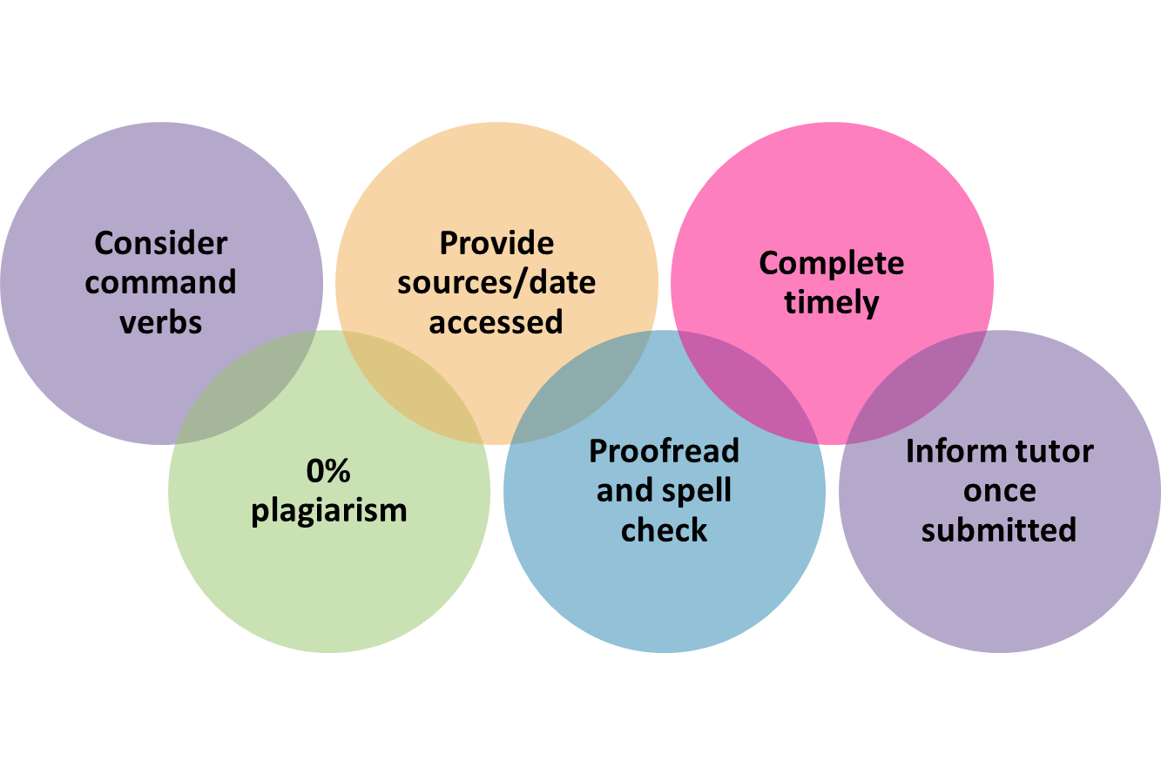
Assessment Activity
Unit 001 Games Design and Development & Introduction to Programming
Assessment 1
Notes:
Describe computer game types and platforms.(GDD 1.1)
Q1. Describe two or more computer game types and two or more platforms.
Think about what we have discussed – what will be your focus for today? What do you want to achieve?
11

Slide 12
Unit 001 Assessment 2 Games Design and Development & Introduction to Programming
Level 1 Certificate in Skills for Creative Industries
Notes:
Assessment 2
Outline the key elements of a computer programme (IP 1.1)
Q1. Outline the key elements of a computer programme
Identify different programming languages that can be used to create a simple computer programme. (IP 1.2)
Q2. Identify different programming languages that can be used to create a simple computer programme.
Identify aspects to consider when designing computer games.(GDD 1.2)
Q3. Identify two or more aspects to consider when designing computer games.
12

Slide 13
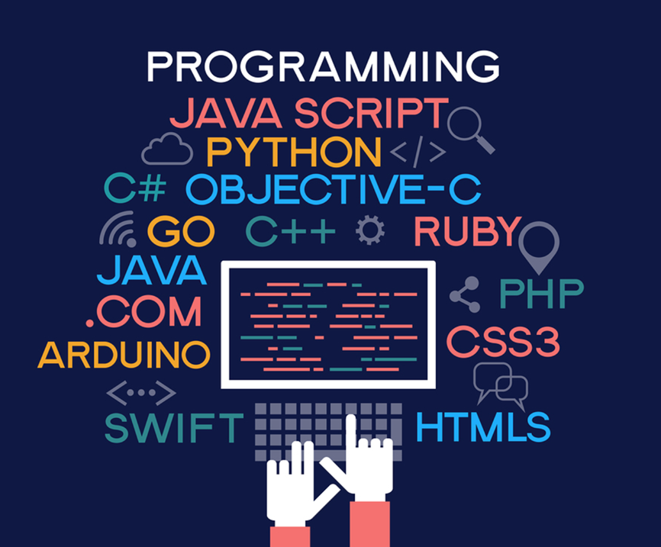
This session
Intent
The purpose of this session is to introduce you to the key elements of a computer programme and the different programming languages used. You will consider important aspects when designing a game so that you can apply this when designing your own game.
Implementation
Define key words such as sequence, selection and pseudocode.
Understand how computers programmes are created.
Know what it means for a computer to apply logic and create codes to allow computers to do this.
Identify different game design aspects.
Impact
Upon completion of this session, you will have an understanding of the basics of programming and will feel confident in defining and using programming language/techniques.
Games Design and Development & Introduction to Programming
Notes:
Assessment 2
Outline the key elements of a computer programme (IP 1.1)
Identify different programming languages that can be used to create a simple computer programme. (IP 1.2)
Identify aspects to consider when designing computer games.(GDD 1.2)

Slide 14
Introduction to Programming
Three basic structures
Notes:
Outline the key elements of a computer programme (IP 1.1)
Q1. Outline the key elements of a computer programme
What is computer programming and why is it important? “How do games get programmed” E.g., giving computers instructions known as code.
Identify how hardware and software work?
“Three basic structures.”
https://www.futurelearn.com/info/courses/programming-101/0/steps/43783

Slide 15
New Vocabulary
Can you define any of the following words?
Pseudocode
Flowchart
Algorithm
Sequence
Selection
Iteration
Notes:
Outline the key elements of a computer programme (IP 1.1)
Q1. Outline the key elements of a computer programme
Q? Ask learners

Slide 16
Notes:
Outline the key elements of a computer programme (IP 1.1)
Q1. Outline the key elements of a computer programme
Programs are written to solve problems. To solve a problem, a program needs data input and data, or information, output.
Data entered into a program, by the programmer, are referred to as inputs. These inputs are stored and used to run the program.
Outputs are where the data from the program is shown to the user, either on screen or in the form of a physical output such as printouts or signals.
A program will require a computer system to perform four main actions in order to communicate with a user:
The user must input data into the system
This data must be processed
The outcome is output to the user
The data is stored for later use

Slide 17
Notes:
Outline the key elements of a computer programme (IP 1.1)
Q1. Outline the key elements of a computer programme
Computational logic is a term that describes the decision-making progress used in programming and writing algorithms; in other words, computational thinking is a way of looking at problems that allows a computer to help us solve them.

Slide 18
Algorithms
Notes:
Assessment 2
Outline the key elements of a computer programme (IP 1.1)
Q1. Outline the key elements of a computer programme
Assessment 4
Develop a simple algorithm using pseudocode for a computer programme to meet a given brief (IP 2.1)
Q1. Develop a simple algorithm using pseudocode for a computer programme to meet a given brief.

Slide 19
Logical Structures x 3
One
Sequence: Running instructions in order
Two
Selection: making choices
Three
Iteration: doing the same thing more than once
Notes:
Outline the key elements of a computer programme (IP 1.1)
Q1. Outline the key elements of a computer programme
Assessment 4
Develop a simple algorithm using pseudocode for a computer programme to meet a given brief (IP 2.1)
Q1. Develop a simple algorithm using pseudocode for a computer programme to meet a given brief.
Structure statements are developed and defined by using the following types of statements:
Sequence Structure: This is the single step or action included in the sequence process; it does not depend on the existence of other conditions. If the sequence structure does encounter a condition, it is taken into consideration.
Decision Structure: This occurs when two or more actions rely on the value of a specific condition. The condition is expanded and the necessary decisions are made.
Iteration/Repetition Structure: Certain conditions will only occur after specific conditions are executed. Iterative instructions help an analyst describe these specific cases.
Discuss the points.

Slide 20
The Application of Logic
Computers use logic to make decisions and run programs. You can use logic to work out what a program/computer system is likely to do. Computers solve problems with logic and then they store data.
A computer system is based on a two-value logic system. Here are some key terms:
1/0
On/off
Yes/no
A computer will perform calculations using computational logic and logic gates:
And
Or
Not
Input/output
Truth tables
Notes:
Assessment 2
Outline the key elements of a computer programme (IP 1.1)
Q1. Outline the key elements of a computer programme
Assessment 4
Develop a simple algorithm using pseudocode for a computer programme to meet a given brief (IP 2.1)
Q1. Develop a simple algorithm using pseudocode for a computer programme to meet a given brief.
Discuss points made in more detail.
Boolean logic
A computer is basically a collection of transistors and circuits. These components have two states:
on - a current is flowing through the component
off - a current is not flowing through the component
These two states can easily be represented by using binary:
1 = on (TRUE)
0 = off (FALSE)
Boolean logic can be used to check if the values of different states are the same or different when compared. When George Boole was studying mathematical theories, he discovered a relationship between algebra and logic. This led to the idea that by comparing different states using three main conditions, this would always output a true or false value. This later became known as a Boolean data type.
The three main types of condition are:
AND
OR
NOT

Slide 21
Applying Logic
If you want a computer to tell someone whether they are old enough to drive a car (Age 17), you need to set the computer to think logically.
The computer uses the information it has been given to make a decision. It uses VARIABLES to help the decision-making process. The variable here is the age of the person inputting the information.
The computer follows a SEQUENCE to work through the problem.
If the answer is =>17 you can drive a car. This is how it could work:
OUTPUT ‘How old are you?’
INPUT (you input your age)
(The computer stores this input and then applies logic by using the age variable to check the answer)
IF =>17 THEN OUTPUT
‘You can drive a car’
ELSE IF =<17 THEN OUTPUT
‘No, you can’t drive a car’
Notes:
Outline the key elements of a computer programme (IP 1.1)
Q1. Outline the key elements of a computer programme
Talk through the example.

Slide 22
Information as a Flowchart
START
INPUT ‘How old are you’?
When you are thinking of how to programme a computer to do something, you could break the activity down using a flowchart.
For the car example, here’s what this would look like…
Is age >=17?
Yes
OUTPUT ‘You can drive a car’
No
OUTPUT ‘You can’t drive a car’
END
Notes:
Outline the key elements of a computer programme (IP 1.1)
Q1. Outline the key elements of a computer programme
Assessment 4
Develop a simple algorithm using pseudocode for a computer programme to meet a given brief (IP 2.1)
Q1. Develop a simple algorithm using pseudocode for a computer programme to meet a given brief.

Slide 23
Pseudocode “What is it?”
While answer == “computer science”
Input “What is your favourite subject?” answer
If answer == “computer science”
output “Good choice!”
end if
else
output “Really!”
repeat
Pseudocode is not an actual programming language.
Instead, it is a simple way of describing a set of instructions in a manner that resembles a programming language.
Designing algorithms with pseudocode
Notes:
Assessment 4
Develop a simple algorithm using pseudocode for a computer programme to meet a given brief (IP 2.1)
Q1. Develop a simple algorithm using pseudocode for a computer programme to meet a given brief.
Designing algorithms with pseudocode - Designing algorithms - Eduqas - GCSE Computer Science Revision - Eduqas - BBC Bitesize

Slide 24
Structured English vs Pseudocode
Notes:
Assessment 4
Develop a simple algorithm using pseudocode for a computer programme to meet a given brief (IP 2.1)
Q1. Develop a simple algorithm using pseudocode for a computer programme to meet a given brief.

Slide 25
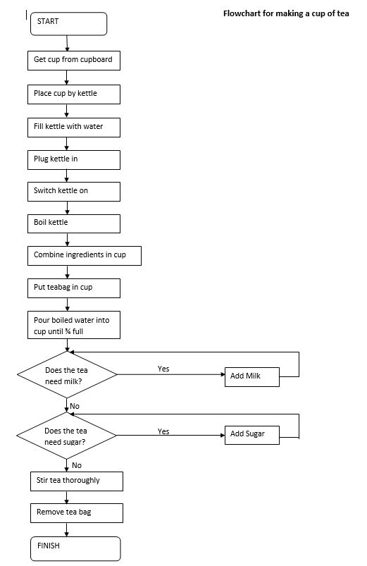
Pseudocode
Making a cup of tea
Flowchart
Notes:
Assessment 4
Develop a simple algorithm using pseudocode for a computer programme to meet a given brief (IP 2.1)
Q1. Develop a simple algorithm using pseudocode for a computer programme to meet a given brief.

Slide 26
Programming Languages
20minute activity – In teams, research computer languages and their uses
Click here to go to Jamboard
Notes:
Identify different programming languages that can be used to create a simple computer programme. (IP 1.2)
Q2. Identify different programming languages that can be used to create a simple computer programme.
Watch video then jamboard

Slide 27
Break Out Room
20 minutes
Mutual Respect & Tolerance
Mutual respect is the foundation for honesty and truth and meaningful communication.
Britain is a multi-cultural country and many different faiths and beliefs are celebrated here.
In Britain we pride ourselves on living in peace with one another.
Individual Liberty
Individual Liberty is being free from oppressive restrictions that we work hard to protect.
It is important to remember the sacrifice people have made to preserve our individual liberty, such as WW1 & WW2.
We have the freedom to choose how we live our lives.
The Rule of Law
All people and institutions are subject to and accountable to law that is fairly applied and enforced, no one is above the law.
Democracy
Democracy means that we have a say in what happens.

Slide 28
Top 10 Programming Languages
C
C++
C#
Python
Go
Java
Javascript
PHP
R
Swift
5 minutes
Python
Javascript
Java
C#
C
C++
Go
R
Swift
PHP
Top 20 Best Programming Languages To Learn in 2023
Notes:
Identify different programming languages that can be used to create a simple computer programme. (IP 1.2)
Q2. Identify different programming languages that can be used to create a simple computer programme.
Discuss findings from breakout rooms
Research computer languages and their uses
A programming language is a set of instructions that a human can write. This then is converted into a language that a computer can understand. (machine code). There are many types of programming languages such as Java, Python, HTML. For example, A programme language for an android device would be Java. For a website it would be PHP.
A programming language is a language used to communicate with a computer. It is a given set of instructions to a computer in a language the computer understands.
Think of Programming language as when code is written to instruct a computer to do certain things.
It is a set of instructions that tell the computer what to do.
It is the use of electrical signals and data formed by programmers to control software and components in a computer.
Languages are used for different purposes.
Each offers a different function and is tailored to certain aspects of software and hardware. For example; Python is used to 'print' messages or information to a screen, JavaScript is used to embed and run media, HTML is the language used to form a website, it forms the framework and content/layout to be shown on the page.
Pose – Name a language – bounce – what is it used for
C language is a popular choice for video games.
Python – multi-purpose that emphasises readability and is used by Google, FB and YT.
Javascript – for making web pages and websites alongside HTML/CSS (most popular language)
Ruby – high level language
Java – general purpose & cross platform programming language, originally called Oak, named after the tree outside its inventors window (James Gosling) Even though Java doesn't provide the same level of intricate control as C++, many see it as the best language for game development. Java's popularity is partially due to its ease of use, which makes it a great solution for many new Game Developers, it’s commonly used for programming mobile phones. The name originates from Java Coffee, a type of coffee from Indonesia.
C/C++ Are languages used for system and application software. C++ was originally an extension of C and is commonly used for gaming development.
Functional languages are used to store data to perform recursive functions (which execute and repeat it to solve any errors during programming). Eg Cunieform, PureScript & APL
Machine languages are made up of binary code, which is a series of 0/1 that symbolise text or instructions for a computer programme. Eg Fortran.
HTML = Hyper Text Markup Language and falls under Mark up language. HTML is used for coding web pages, things like headings and paragraphs and commands a computer interface on how elements should be displayed.
Link: what languages are there and what are they used for
https://www.simplilearn.com/best-programming-languages-start-learning-today-article#16_html
Click on timer to start
Split the group into two rooms
Give them 5 minutes to put the top 10 languages in order of popularity (NO GOOGLING!)
Get them back together and see which group gets the most right
C
C++
C#
Python
Go
Java
Javascript
PHP
R
Swift
Top 10 Most Popular Programming Languages
1. Python
Number of jobs: 19,000
Benefits: Python is widely regarded as a programming language that’s easy to learn, due to its simple syntax, a large library of standards and toolkits, and integration with other popular programming languages such as C and C++. In fact, it’s the first language that students learn in the Align program, Gorton says. “You can cover a lot of computer science concepts quickly, and it’s relatively easy to build on.” It is a popular programming language, especially among startups, and therefore Python skills are in high demand.
Drawbacks: Python is not suitable for mobile application development.
Common uses: Python is used in a wide variety of applications, including artificial intelligence, financial services, and data science. Social media sites such as Instagram and Pinterest are also built on Python.
2. JavaScript
Number of jobs: 24,000
Benefits: JavaScript is the most popular programming language for building interactive websites; “virtually everyone is using it,” Gorton says. When combined with Node.js, programmers can use JavaScript to produce web content on the server before a page is sent to the browser, which can be used to build games and communication applications that run directly in the browser. A wide variety of add-ons extend the functionality of JavaScript as well.
Drawbacks: Internet browsers can disable JavaScript code from running, as JavaScript is used to code pop-up ads that in some cases can contain malicious content.
Common uses: JavaScript is used extensively in website and mobile application development. Node.js allows for the development of browser-based applications, which do not require users to download an application.
3. Java
Number of jobs: 29,000
Benefits: Java is the programming language most commonly associated with the development of client-server applications, which are used by large businesses around the world. Java is designed to be a loosely coupled programming language, meaning that an application written in Java can run on any platform that supports Java. As a result, Java is described as the “write once, run anywhere” programming language.
Drawbacks: Java is not ideal for applications that run on the cloud, as opposed to the server (which is common for business applications). In addition, the software company Oracle, which owns Java, charges a licensing fee to use the Java Development Kit.
Common uses: Along with business applications, Java is used extensively in the Android mobile operating system.
4. C#
Number of jobs: 18,000
Benefits: Microsoft developed C# as a faster and more secure variant of C. It is fully integrated with Microsoft’s .NET software framework, which supports the development of applications for Windows, browser plug-ins, and mobile devices. C# offers shared codebases, a large code library, and a variety of data types.
Drawbacks: C# can have a steep learning curve, especially for resolving errors. It is less flexible than languages such as C++.
Common uses: C# is the go-to language for Microsoft ad Windows application development. It can also be used for mobile devices and video game consoles using an extension of the .NET Framework called Mono.
5. C
Number of jobs: 8,000
Benefits: Along with Python and Java, C forms a “good foundation” for learning how to program, Gorton says. As one of the first programming languages ever developed, C has served as the foundation for writing more modern languages such as Python, Ruby, and PHP. It is also an easy language to debug, test, and maintain.
Drawbacks: Since it’s an older programming language, C is not suitable for more modern use cases such as websites or mobile applications. C also has a complex syntax as compared to more modern languages.
Common uses: Because it can run on any type of device, C is often used to program hardware, such as embedded devices in automobiles and medical devices used in healthcare.
6. C++
Number of jobs: 9,000
Benefits: C++ is an extension of C that works well for programming the systems that run applications, as opposed to the applications themselves. C++ also works well for multi-device and multi-platform systems. Over time, programmers have written a large set of libraries and compilers for C++. Being able to use these utilities effectively is just as important to understanding a programming language as writing code, Gorton says.
Drawbacks: Like C, C++ has complex syntax and an abundance of features that can make it complicated for new programmers. C++ also does not support run-time checking, which is a method of detecting errors or defects while software is running.
Common uses: C++ has many uses and is the language behind everything from computer games to mathematical simulations.
7. Go
Number of jobs: 1,700
Benefits: Also referred to as Golang, Go was developed by Google to be an efficient, readable, and secure language for system-level programming. It works well for distributed systems, in which systems are located on different networks and need to communicate by sending messages to each other. While it is a relatively new language, Go has a large standards library and extensive documentation.
Drawbacks: Go has not gained widespread use outside of Silicon Valley. Go does not include a library for graphical user interfaces, which are the most common ways that end-users interact with any device that has a screen.
Common uses: Go is used primarily for applications that need to process a lot of data. In addition to Google, companies using Go for certain applications include Netflix, Twitch, and Uber.
8. R
Number of jobs: 1,500
Benefits: R is heavily used in statistical analytics and machine learning applications. The language is extensible and runs on many operating systems. Many large companies have adopted R in order to analyse their massive data sets, so programmers who know R are in great demand.
Drawbacks: R does not have the strict programming guidelines of older and more established languages.
Common uses: R is primarily used in statistical software products.
9. Swift
Number of jobs: 1,800
Benefits: Swift is Apple’s language for developing applications for Mac computers and Apple’s mobile devices, including the iPhone, iPad, and Apple Watch. Like many modern programming languages, Swift has a highly readable syntax, runs code quickly, and can be used for both client-side and server-side development.
Drawbacks: Swift can only be used on newer versions of iOS 7 and will not work with older applications. As a newer programming language, the code can be unstable at times, and there are fewer third-party resources available to programmers.
Common uses: Swift is used for iOS and macOS applications.
10. PHP
Number of jobs: 7,000
Benefits: PHP is widely used for server-side web development, when a website frequently requests information from a server. As an older language, PHP benefits from a large ecosystem of users who have produced frameworks, libraries, and automation tools to make the programming language easier to use. PHP code is also easy to debug.
Drawbacks: As Python and JavaScript have gained popularity, PHP’s popularity has dropped. PHP is also known for its security vulnerabilities. According to Indeed, most PHP programmers take short-term roles that last less than one year.
Common uses: PHP is the code running content-oriented websites such as Facebook, WordPress, and Wikipedia.
Which Programming Language Should You Learn?
Some programmers are able to build a career out of being an expert in one language, but many programmers learn new languages frequently, Gorton says. It’s not uncommon for a professional programmer to be fluent in three or four different languages, he adds.
The type of software you want to develop is one consideration for which programming languages to learn. While there are no concrete rules for what language is used to write what software, a few trends offer some guidance:
Web-based start-ups are more likely to be programming in Python and JavaScript.
Larger companies tend to develop their internal software applications using C# or Java and their Web applications using PHP.
Programs for data analytics typically use the R and MATLAB programming languages.
Embedded devices, such as those in the automotive and healthcare industries, run software written in C, C++, or Rust.
Applications that run on the cloud are increasingly written in Go or Scala.
Mobile applications are increasingly written in Swift or Kotlin.

Slide 29
Programming Languages
Text-based programming languages | Write lines and lines of code which can be time-consuming. Higher level of technical knowledge required to understand the set of rules. These rules tell you how to combine instructions so the computer can understand them.
Graphical programming languages | Visual and therefore less intimidating to learn. Commands to choose from so no need to memorise. Easy for beginners to start coding. No syntax (rules) errors.
Notes:
Identify different programming languages that can be used to create a simple computer programme. (IP 1.2)
Q2. Identify different programming languages that can be used to create a simple computer programme.
Discuss slide and learners to make notes.

Slide 30
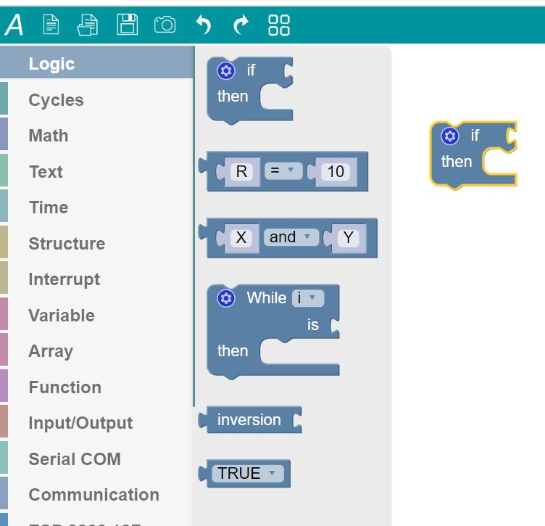
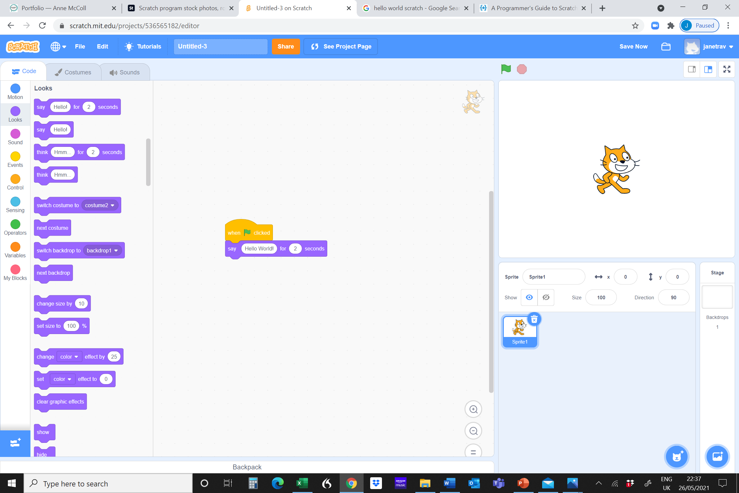
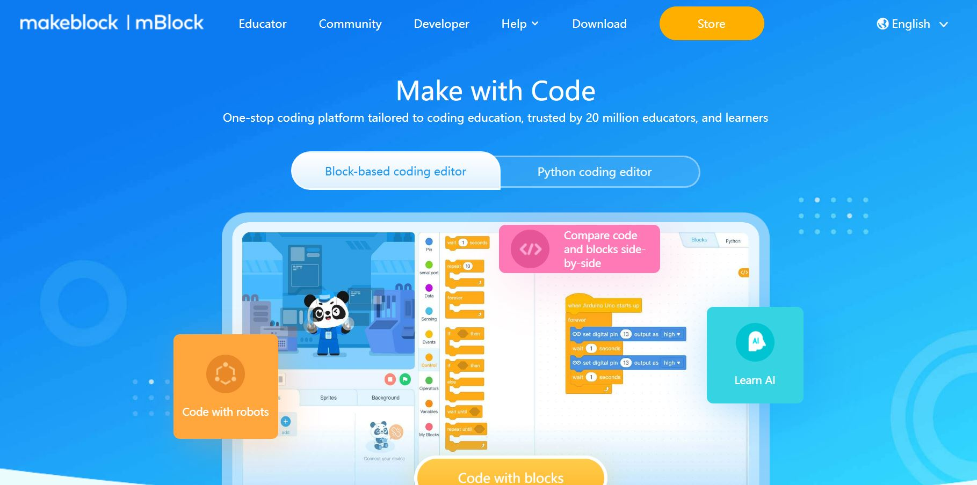
Graphic Programming
Graphic or visual programming use visual objects like symbols, blocks, pictures, etc. to code the program.
These representations of physical objects are connected through arrows, arcs, lines, or wires to make the system understand what to perform and how to perform the instructions.
Unlike text-based programming, it instructs the system with the help of the arrangement of the objects.
The source code is graphical, and the code block tells the program what to do.
Ardublock
Scratch
mBlock
(Make Block)
Notes:
Identify different programming languages that can be used to create a simple computer programme. (IP 1.2)
Q2. Identify different programming languages that can be used to create a simple computer programme.
Discuss

Slide 31
Graphic-based VS Text-based
A Hello World Program written in…
Scratch and C++
Both of these examples are the same program Which looks easier? Why?
Notes:
Identify different programming languages that can be used to create a simple computer programme. (IP 1.2)
Q2. Identify different programming languages that can be used to create a simple computer programme.

Slide 32
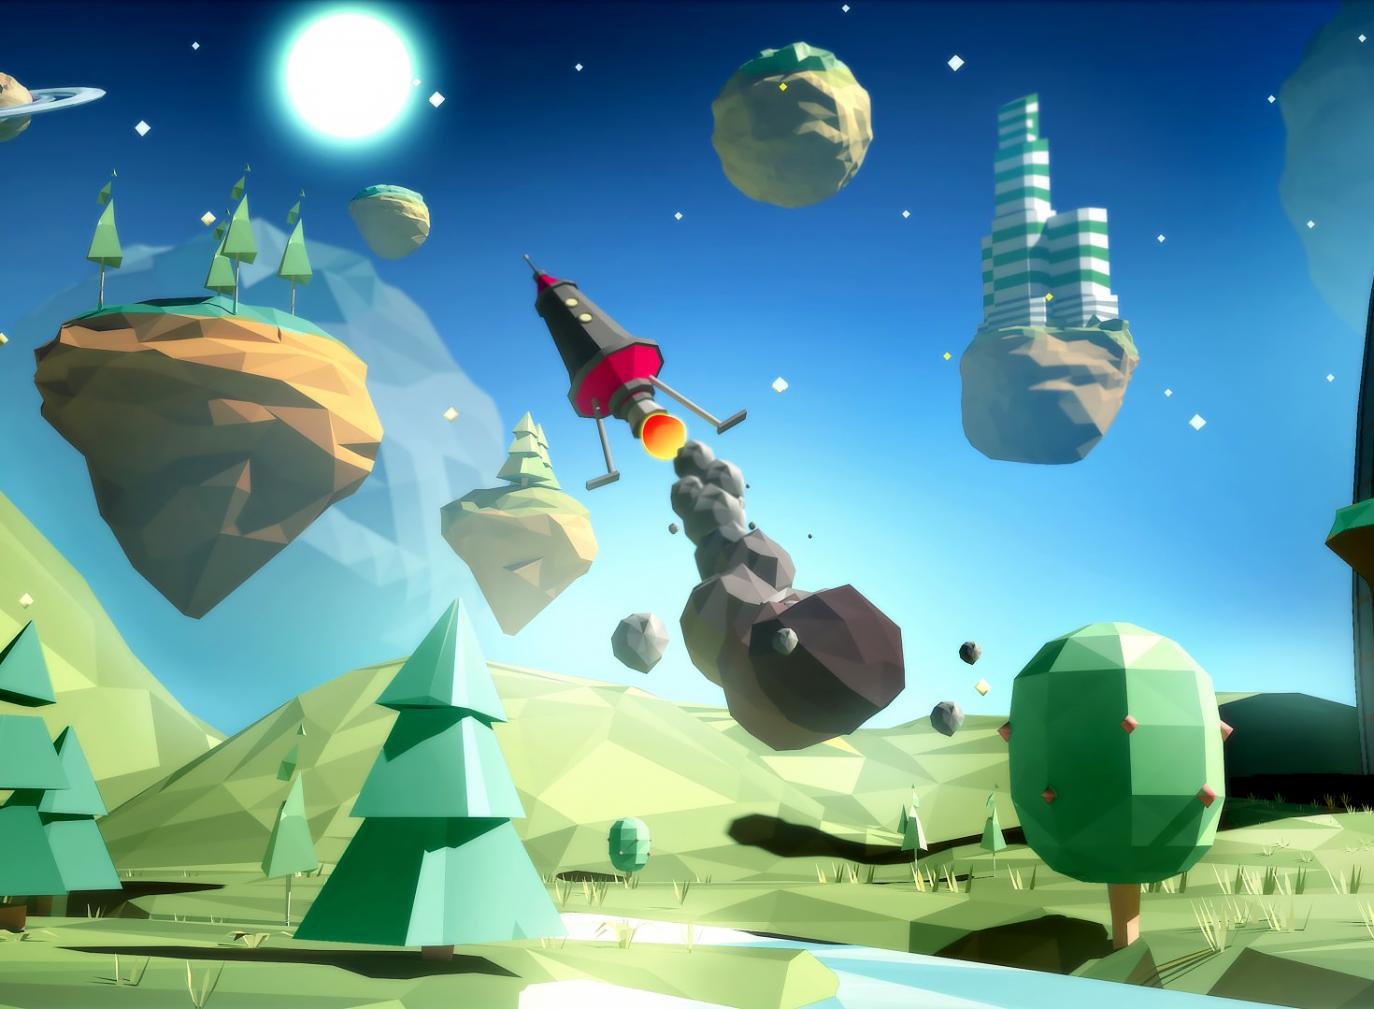
Why is graphics programming used?
Graphic programming
Teaching programming
Storytelling
Video games
Data visualisation
Notes:
Identify different programming languages that can be used to create a simple computer programme. (IP 1.2)
Q2. Identify different programming languages that can be used to create a simple computer programme.
Teaching programming
Many universities and schools teach visual type coding as an introduction to programming.
Storytelling
The interaction and arrangements of images and graphics are used to describe a story. This may be the useful application of visual programming. For example, doctors can show how human body cells are described using simulations and spatial arrangements.
Video games
Video games are an extension of simulations that interact with the player. Many game developers use a visual programming language to design the interface and the game’s back end.
Data visualization
Many companies have to manipulate a large amount of data. They use graphics programming to summarize the data and make them understandable by the graphical ordering.

Slide 33
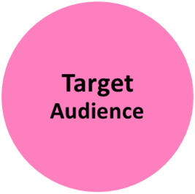
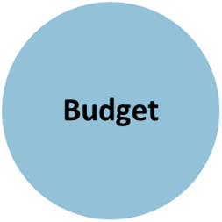
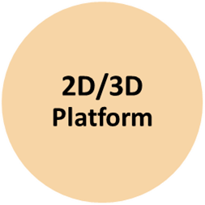
Aspects to consider in Games Design
Theme could include
Superheroes
Martial Arts
Pirates
Fantasy
Puzzle
Target Audience:
Your target audience is the demographics and interests of the majority of its players. For example, if you’re launching a match-3 puzzle game, your target audience is likely female, 35 years of age, and cares mostly about achievement over all other aspects
Budget
Testing
Marketing
Making a trailer
Advertising
Buying assets
Attend trade shows
Demo game then
pitch to publishers
Market Demand/
Competition
Which are the most popular video games to be playing this year?
2D/3D Platform:-
3D games might require more time and effort to develop than 2D games. 3D games generally have more lengthy gameplay times than 2D. So, they need more effort and time to develop.
Resources
Games Design
Programming/Developer
Game Art/Music
Marketing
Games industry value
Notes:
Identify aspects to consider when designing computer games GDD 2.1
Q3. Identify two or more aspects to consider when designing computer games.
If you are designing a game, what do you need to consider?
Link: Talk about the industry - https://www.thecreativeindustries.co.uk/site-content/uk-consumer-games-market-worth-ps7-12bn-in-2021 – was 7.16bn in 2021, now 7.05bn 2022

Slide 34
Did we achieve?
Intent
The purpose of this session is to introduce you to the key elements of a computer programme and the different programming languages used. You will consider important aspects when designing a game so that you can apply this when designing your own game.
Implementation
Define key words such as sequence, selection and pseudocode.
Understand how computers programmes are created.
Know what it means for a computer to apply logic and create codes to allow computers to do this.
Identify different game design aspects.
Impact
Upon completion of this session, you will have an understanding of the basics of programming and will feel confident in defining and using programming language/techniques.
Games Design and Development & Introduction to Programming
Notes:
Assessment 2
Outline the key elements of a computer programme (IP 1.1)
Q1. Outline the key elements of a computer programme
Identify different programming languages that can be used to create a simple computer programme. (IP 1.2)
Q2. Identify different programming languages that can be used to create a simple computer programme.
Identify aspects to consider when designing computer games.(GDD 1.2)
Q3. Identify two or more aspects to consider when designing computer games.

Slide 35
Assessment Activity
Unit 001 Games Design and Development & Introduction to Programming
Assessment 2
Notes:
Think about what we have discussed – what will be your focus for today? What do you want to achieve?
35

Slide 36
Unit 001 Assessment 3 Games Design and Development & Introduction to Programming
Level 1 Certificate in Skills for Creative Industries
Notes:
Assessment 3
Use a range of information sources to research computer game design ideas. (GDD 2.1)
Q1. Evidence that you have used a range of information sources to research computer game design ideas.
Use tools and techniques to create a game prototype. (GDD 3.1)
Q2. Evidence that you have used two or more tools and techniques to create a basic game prototype, with some animation and interaction.
Create an asset list of primary elements (GDD 2.3)
Q3. Use the table below to create an asset list of your game's primary elements, and upload the concept imagery (GDD 2.2 and 2.3)
36

Slide 37
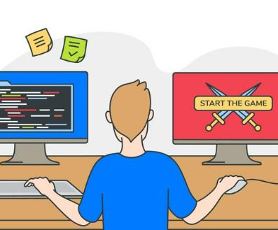
This session
Intent
The purpose of this session is to analyse different games, to gather ideas and images to use in your own game.
Implementation
Research information sources
Understand how computers programmes are created.
Create a games design proposal
Create an asset list of concept imagery
Impact
Upon completion of this session, you will have researched game ideas and created a design proposal with concept imagery to use in your own game.
Games Design and Development & Introduction to Programming
Notes:
Assessment 3
Use a range of information sources to research computer game design ideas. (GDD 2.1)
Q1. Evidence that you have used a range of information sources to research computer game design ideas.
Use tools and techniques to create a game prototype. (GDD 3.1)
Q2. Evidence that you have used two or more tools and techniques to create a basic game prototype, with some animation and interaction.
Create an asset list of primary elements (GDD 2.3)
Q3. Use the table below to create an asset list of your game's primary elements, and upload the concept imagery (GDD 2.2 and 2.3)

Slide 38
Generate ideas and plan a game design
Chess?
How do ideas happen?
Primary sources (Consider Your own work)
Secondary Sources
Existing sources
Cooking?
Trains?
What makes a good game
Notes:
Use a range of information sources to research computer game design ideas. (GDD 2.1)
Q1. Evidence that you have used a range of information sources to research computer game design ideas.
10 minute video - https://www.youtube.com/watch?v=TOQTZ6N_eVg
Primary sources (e.g., observation drawings, photographs, visits). This could also include their work they have completed for Digital Photography and Photo Editing Software units as these will be original resources.
Secondary sources (e.g., practitioner research, books, websites, blogs).
Existing products (e.g., 2D games, 3D games, websites, apps, interactive TV). could be in the form of a mind map “Copyright look at royalty free, Extended tasks” Sky Q, BBC iPlayer, ITV Hub as examples
2.1 ITP Identify and develop a simple algorithm using pseudocode for a computer programme to meet a given brief.
Design a simple computer program to a given brief, using an algorithm.
Writing an algorithm – set of steps to be followed to solve a problem.
Support learners to set up a Scratch account.

Slide 39
Games design
Characters
Setting
Story/plot
Game controls
Milanote Games Designer
What makes a good game?
Notes:
Use a range of information sources to research computer game design ideas. (GDD 2.1)
Q1. Evidence that you have used a range of information sources to research computer game design ideas.
Create a game design proposal and concept imagery (GDD 2.2)
Q2. In the previous question, you have undertaken research using a range of sources to help generate ideas for a game. Please answer the questions below to help generate a game design proposal and provide basic information on your game idea.
Create an asset list of primary elements (GDD 2.3)
Q3. Use the table below to create an asset list of your game's primary elements, and upload the concept imagery (GDD 2.2 and 2.3)
Show Milanote
Gamemaker is free option unless you want to export your game to another platform
https://gamemaker.io/en
Designing games
All games come from a basic idea that is then developed into a game.
One of the earliest computer games was called Pong. Pong simply allowed you to play a game of table tennis on a computer. It was very popular from the moment it was launched.
Coming up with an idea
So the first thing to do is come up with the idea for your game. You could start with a pirate looking for lost treasure, a vet caring for animals on a safari park or a spaceship captain exploring an alien galaxy.
When you are coming up with your idea you can ask yourself questions. For example, what is the objective? What are the rules?
Genre
There are lots of different types of games. These types are called genres. Different genres include: racing games, adventure games, puzzle games and platform games.
Once you have your idea and have decided on a genre you can start designing your game.
Who will be the hero of your game? You could sketch out your character and think of adventures to send them on.
What makes games fun?
Everyone has their own opinion about what makes a good game. But a game usually needs good graphics, interesting stories, characters and nice music to make it enjoyable. Other aspects that are important include: Other considerations are the characters, visuals and music or sound effects which can totally change the feel and mood of the game which will have an impact on the appeal for your audience.
Gameplay
How the game plays is very important. While the look of games has changed a lot over the years it is gameplay that makes you want to play a game. Games must be fun and entertaining.
Difficulty
Challenge is really important in games. If the game is too hard you might become frustrated with it and give up. If a game is too easy you might finish it too quickly and find it boring. Games need to balance these two extremes.
Feedback
Giving the player feedback is also important. This could be a simple score or unlocking skills or extra levels for players who do very well.
What makes a good computer game? Link to further info
https://www.bbc.co.uk/bitesize/topics/zkcqn39/articles/zw96tfr
Games keep us coming back
Computer games have a few methods of keeping players coming back for more.
Games will often increase their difficulty and introduce new game mechanics to keep the player interested. The difficulty will normally change as you get further into the game. Enemies might become harder to defeat or the speed of the game might increase.
New mechanics can be introduced as the game progresses. This could be adding new powers like a super jump or skills to open locked doors.
Tutorials
A tutorial is a section or level at the start of a game that shows you how to play. Tutorials are common in modern games.
As you progress through a computer game the difficulty will usually increase.
How can you program a computer game?
Games sold by companies use complex code. Often there is so much code that it has to be ‘decomposed’ (made into smaller parts or elements). Each of these smaller elements can then be programmed.
Simple games can be programmed using programming languages like Scratch, Kodu or Project Spark.
If you want to make your own computer game you might need to think about:
How will a sprite move across the screen? (A sprite is a computer graphic such as a character.)
What rules control the world your character lives in? Is there gravity in your game?
How will enemies behave and move?
What happens when the world, the sprites and the enemies come into contact?
Answering these questions is part of the development process. It will give you an idea of how your game will behave, which will help you make the best game you can.
The story – what do the game characters have to do?
The characters – who are the heroes? What about the villains?
Game controls – How is the game played? What controls are used?
Game goals – How do you win or lose the game? What is the aim?
The graphics and artwork – Do they bring the characters to and setting to life?
The setting – What kind of place and time is the game set?

Slide 40
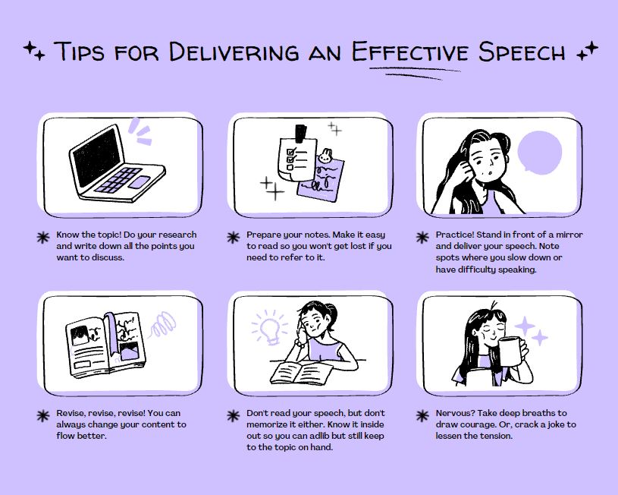
Storyboards
Create a free account with Canva: The link is on the VLE (search for storyboards).
Example…
Create a storyboard, a visual representation of playing the game
Notes:
Create a game design proposal and concept imagery (GDD 2.2)
Q2. In the previous question, you have undertaken research using a range of sources to help generate ideas for a game. Please answer the questions below to help generate a game design proposal and provide basic information on your game idea.
Create an asset list of primary elements (GDD 2.3)
Q3. Use the table below to create an asset list of your game's primary elements, and upload the concept imagery (GDD 2.2 and 2.3)
Storyboard (walk through screenshots of the interactive elements in the game)
Use Milanote or Canva

Slide 41
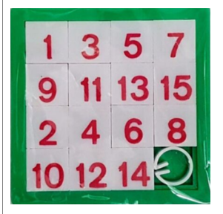
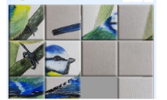
Primary source: Own artwork
Existing source:
Sliding puzzle invented 1880
Notes:
Create an asset list of primary elements (GDD 2.3)
Q3. Use the table below to create an asset list of your game's primary elements, and upload the concept imagery (GDD 2.2 and 2.3)
Visual examples

Slide 42
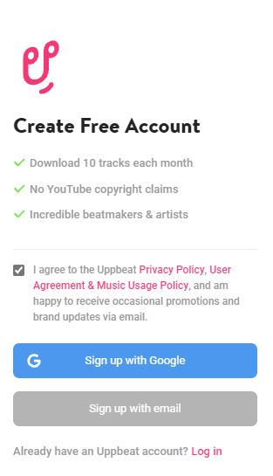
Sound Files
Sound files
Sign up for Uppbeat to access copyright free music for your game
Uppbeat
Ensure you choose Free Account
Notes:
Create a game design proposal and concept imagery (GDD 2.2)
Q2. In the previous question, you have undertaken research using a range of sources to help generate ideas for a game. Please answer the questions below to help generate a game design proposal and provide basic information on your game idea.
Create an asset list of primary elements (GDD 2.3)
Q3. Use the table below to create an asset list of your game's primary elements, and upload the concept imagery (GDD 2.2 and 2.3)
Use of sound (provide sound file into the VLE for verification and marking)
Or use Pixabay free sound effects

Slide 43
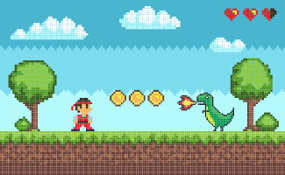
Designing your Game
Step 1. Start with a Plan
Step 2. Set up your main character
Step 3. Pick out a backdrop
Step 4. Add an objective
Step 5. Add more features!
How to Make a Game on Scratch Step-by-Step
Notes:
Use tools and techniques to create a game prototype. (GDD 3.1)
Q2. Evidence that you have used two or more tools and techniques to create a basic game prototype, with some animation and interaction.

Slide 44
Game Creation in Scratch
Essential Elements:
Background image/sprites
Animation
Scoring system or timer
Sound file
Optional:
Input box for name
Output when game finishes
Notes:
Create an asset list of primary elements (GDD 2.3)
Q3. Use the table below to create an asset list of your game's primary elements, and upload the concept imagery (GDD 2.2 and 2.3)

Slide 45
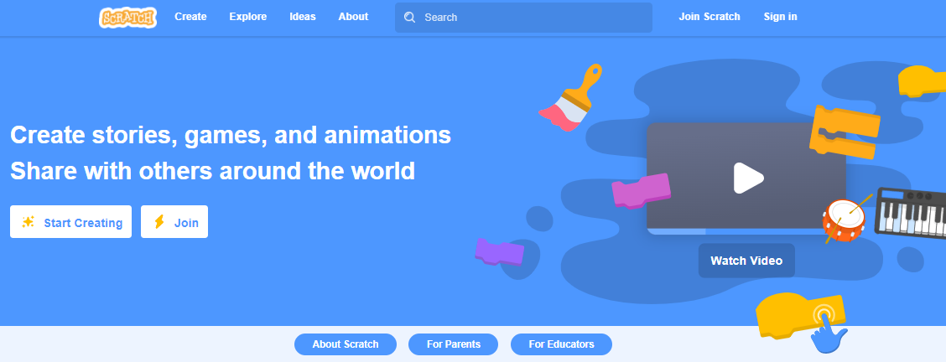
Click on Create to start a new project
You will create an account on Scratch
Set up a free Scratch account at https://scratch.mit.edu
.
Notes:
https://scratch.mit.edu/
Use tools and techniques to create a game prototype. (GDD 3.1)
Q2. Evidence that you have used two or more tools and techniques to create a basic game prototype, with some animation and interaction.
Create a simple computer programme to meet a given brief using programming language. (IP 3.1)
Q3. Evidence that you have created a computer programme (your game) using a programming language.
Use tools and techniques to create a game prototype (GDD 3.1)
Q2. Evidence that you have used two or more tools and techniques to create a basic game prototype, with some animation and interaction.
Check learners have access to Scratch – remind to verify email to be able to share game at the end.

Slide 46
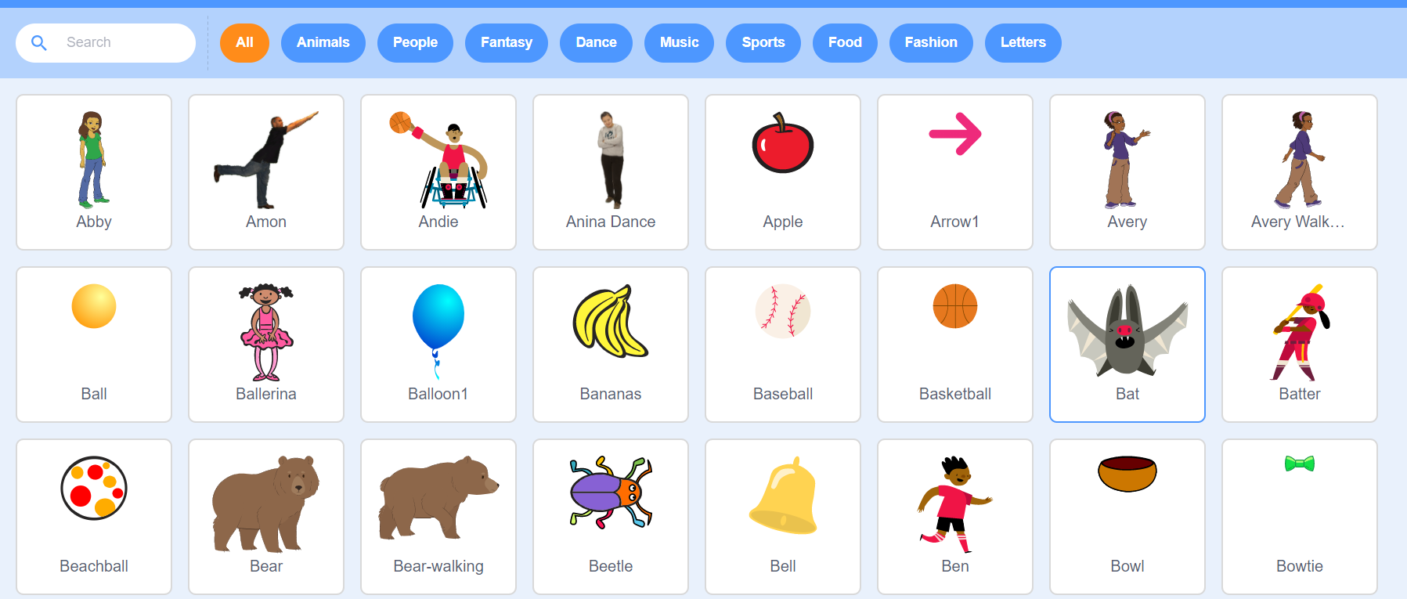
What does Scratch look like?
You can scroll through the tabs or use the search bar to look for something you want.
Change the sprite by clicking on the bin in the top right corner of the sprite.
Click on the sprite button to pull up the options. Then click on the magnifying glass to look at the options available.
Notes:
Use tools and techniques to create a game prototype. (GDD 3.1)
Q2. Evidence that you have used two or more tools and techniques to create a basic game prototype, with some animation and interaction.
Go through the points – ask the learners to select a new sprite.

Slide 47
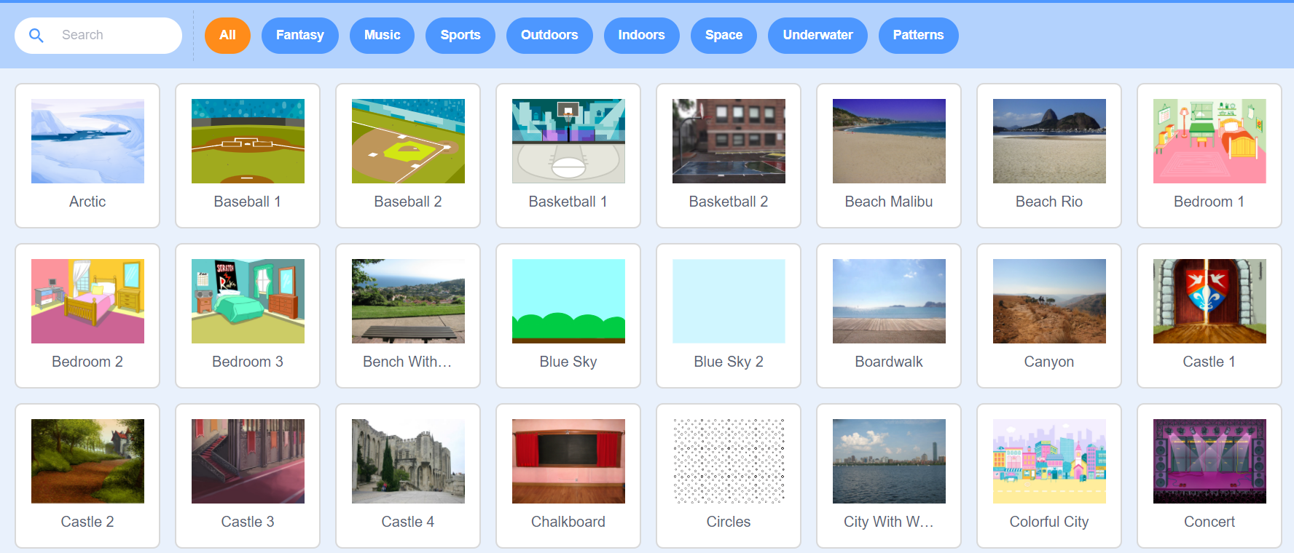
Changing the background…
This works very similarly to changing sprites. The default is white.
Click on the Backdrop button and use the magnifying glass to search for a backdrop…
Notes:
Use tools and techniques to create a game prototype. (GDD 3.1)
Q2. Evidence that you have used two or more tools and techniques to create a basic game prototype, with some animation and interaction.
Ask the learners to experiment changing the background.

Slide 48
Make a Game with Scratch
Notes:
Use tools and techniques to create a game prototype. (GDD 3.1)
Q2. Evidence that you have used two or more tools and techniques to create a basic game prototype, with some animation and interaction.
Watch the video
https://youtu.be/4bhIEoke13w
Explain to the learners that you are all going to work on developing a game using Scratch. This is a dinosaur game where the dinosaur catches eggs. Go through the video slowly, pausing to allow the learners to follow the instructions. Tell them to make notes as they work through the activity as they will need these to create another game
Video source: Introduction to Scratch 3.0 (Game Tutorial), Mr Matthews - https://www.youtube.com/watch?v=4bhIEoke13w

Slide 49
Designing your Game
When the game is complete, go to the username in the top right-hand corner of the screen and select My Stuff.
Find the game that you have created and add instructions.
Notes:
Use tools and techniques to create a game prototype. (GDD 3.1)
Q2. Evidence that you have used two or more tools and techniques to create a basic game prototype, with some animation and interaction.

Slide 50
Did we achieve?
Intent
The purpose of this session is to introduce you to Scratch. You will analyse different games and gather ideas and images to use in your own game.
Implementation
Research information sources
Understand how computers programmes are created.
Create a games design proposal
Create an asset list of concept imagery
Impact
Upon completion of this session, you will have researched game ideas and created a design proposal with concept imagery to use in your own game. You will have a basic understanding of Scratch and how to create your own game.
Games Design and Development & Introduction to Programming
Notes:
Assessment 3
Use a range of information sources to research computer game design ideas. (GDD 2.1)
Q1. Evidence that you have used a range of information sources to research computer game design ideas.
Use tools and techniques to create a game prototype. (GDD 3.1)
Q2. Evidence that you have used two or more tools and techniques to create a basic game prototype, with some animation and interaction.
Create an asset list of primary elements (GDD 2.3)
Q3. Use the table below to create an asset list of your game's primary elements, and upload the concept imagery (GDD 2.2 and 2.3)

Slide 51
Assessment Activity
Unit 001 Games Design and Development & Introduction to Programming
Assessment 3
Notes:
Think about what we have discussed – what will be your focus for today? What do you want to achieve?
Assessment 3
Use a range of information sources to research computer game design ideas. (GDD 2.1)
Q1. Evidence that you have used a range of information sources to research computer game design ideas.
Use tools and techniques to create a game prototype. (GDD 3.1)
Q2. Evidence that you have used two or more tools and techniques to create a basic game prototype, with some animation and interaction.
Create an asset list of primary elements (GDD 2.3)
Q3. Use the table below to create an asset list of your game's primary elements, and upload the concept imagery (GDD 2.2 and 2.3)
51

Slide 52
Unit 001 Assessment 4 Games Design and Development & Introduction to Programming
Level 1 Certificate in Skills for Creative Industries
Notes:
Assessment 4
Develop a simple algorithm using pseudocode for a computer programme to meet a given brief. (IP 2.1)
Q1. Develop a simple algorithm using pseudocode for a computer programme to meet a given brief.
Use tools and techniques to create a game prototype. (GDD 3.1)
Q2. Evidence that you have used two or more tools and techniques to create a basic game prototype, with some animation and interaction.
Create a simple computer programme to meet a given brief using programming language (IP 3.1)
Q3. Evidence that you have created a computer programme (your game) using a programming language.
Illustrate the code using a range of comments. (IP 3.2)
Q4. Upload a section of your code to illustrate you have used comments.
52

Slide 53
This Session
Intent
The purpose of this session is to develop a simple algorithm, create a prototype game and evidence the steps taken.
Implementation
Develop a simple algorithm of your game using pseudocode
Utilise your ideas and design proposal in your game
Create a game prototype using Scratch
Illustrate the code using comments
Impact
Upon completion of this session, you will have used your ideas from the previous session to create your own game using Scratch. You will evidence your process with screenshots.
Games Design and Development & Introduction to Programming
Notes:
Assessment 3
Develop a simple algorithm using pseudocode for a computer programme to meet a given brief. (IP 2.1)
Q1. Develop a simple algorithm using pseudocode for a computer programme to meet a given brief.
Use tools and techniques to create a game prototype. (GDD 3.1)
Q2. Evidence that you have used two or more tools and techniques to create a basic game prototype, with some animation and interaction.
Create a simple computer programme to meet a given brief using programming language (IP 3.1)
Q3. Evidence that you have created a computer programme (your game) using a programming language.
Illustrate the code using a range of comments. (IP 3.2)
Q4. Upload a section of your code to illustrate you have used comments.

Slide 54
Technical Documentation of your game…
What might these involve?
Visualisation
Structure of programme code
Experimentation
Basic arithmetic
Storyboard
Technical notes
Data types
Variables and Constants
Use of sound
Data input and output used within the game
Notes:
Assessment 4
Develop a simple algorithm using pseudocode for a computer programme to meet a given brief. (IP 2.1)
Q1. Develop a simple algorithm using pseudocode for a computer programme to meet a given brief.
Use tools and techniques to create a game prototype. (GDD 3.1)
Q2. Evidence that you have used two or more tools and techniques to create a basic game prototype, with some animation and interaction.
Create a simple computer programme to meet a given brief using programming language (IP 3.1)
Q3. Evidence that you have created a computer programme (your game) using a programming language.
Describe in the technical section of the proposal theme. (Learner Activity) – Tutor to introduce and explain and draw in learner knowledge where appropriate
Visualisation (Annotated screenshots throughout the process)
Experimentation (Record errors and correct), script (taking evidence of the coding structure, Annotated screenshots)
Storyboard (walkthrough screenshots of the interactive elements in the game),
Technical notes
Use of sound (provide sound file into the VLE for verification and marking)
Structure of program code – eg sequence, selection and iteration used within the game
Basic arithmetic – e.g., plus, minus, multiplication and division used within the game
Data types – e.g., integers, raw strings, Boolean type used within the game
Introduction to variables and constants used within the game
Data input and output used within the game
Comments in code – annotation of the source code – making easier to read used within the game
(The actual game created in Scratch will meet most of the criteria, however a history of their completion of the game will be required to meet the grading)

Slide 55
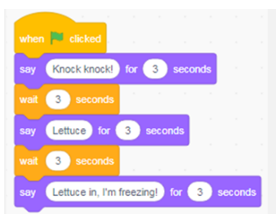
Structure of Programming Code - Sequence
The code follows a sequence
Sequence – control structure in which a set of instructions is each executed once, in the order in which they are written.
Code follows a sequence
A then B then C
Notes:
Use tools and techniques to create a game prototype. (GDD 3.1)
Q2. Evidence that you have used two or more tools and techniques to create a basic game prototype, with some animation and interaction.
Create a simple computer programme to meet a given brief using programming language. (IP 3.1)
Q3. Evidence that you have created a computer programme (your game) using a programming language.

Slide 56
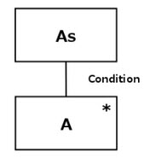
Selection
Iteration
Code follows a selection, if condition is met choose A if not choose B and a condition is used to decide which (if any) statements should be executed.
Code repeats itself until the condition is met.
Think Score 1 to 10, counting up. Once you hit ten: STOP!
Selection – control structure in which an option of statements is provided
Iteration – control structure in which a group of statements is executed repeatedly (like a loop, also called repetition)
Notes:
Use tools and techniques to create a game prototype. (GDD 3.1)
Q2. Evidence that you have used two or more tools and techniques to create a basic game prototype, with some animation and interaction.
Create a simple computer programme to meet a given brief using programming language. (IP 3.1)
Q3. Evidence that you have created a computer programme (your game) using a programming language.
Selection - If /then statement

Slide 57
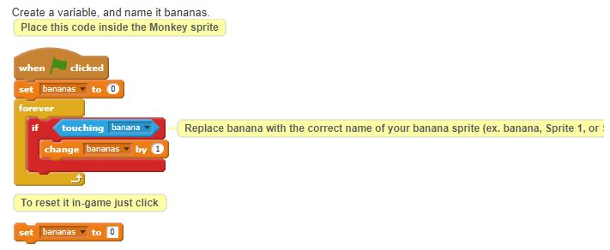
Basic Arithmetic within the Game
Consider the scoreboard in the game, how would we achieve this?
Notes:
Use tools and techniques to create a game prototype. (GDD 3.1)
Q2. Evidence that you have used two or more tools and techniques to create a basic game prototype, with some animation and interaction.
Create a simple computer programme to meet a given brief using programming language. (IP 3.1)
Q3. Evidence that you have created a computer programme (your game) using a programming language.
Basic arithmetic – e.g. plus, minus, multiplication and division.

Slide 58
Data Types in the Game
Boolean - True or False
Char - A single alphanumeric character
String - Stores alphanumeric combinations and text. String is really a group of characters stored together as one
Integer - Stores positive or negative whole numbers
Float – Decimal numbers
Ensure you identify datatypes in your game to submit later
Data Types
Notes:
Use tools and techniques to create a game prototype. (GDD 3.1)
Q2. Evidence that you have used two or more tools and techniques to create a basic game prototype, with some animation and interaction.
Create a simple computer programme to meet a given brief using programming language. (IP 3.1)
Q3. Evidence that you have created a computer programme (your game) using a programming language.
Data types – e.g., integers, raw strings, Boolean type used within the game
Introduction to variables and constants used within the game
https://youtu.be/A37-3lflh8I

Slide 59
Data Input and Output in the Game
The game player will input their name so the game can provide the final score with a name attached, this will be captured with a string datatype.
Output will be a box displaying final score using an integer datatype with their name - string.
Input Name
Paul
User Input – is a key pressed?
Notes:
Assessment 4
Use tools and techniques to create a game prototype. (GDD 3.1)
Q2. Evidence that you have used two or more tools and techniques to create a basic game prototype, with some animation and interaction.
Create a simple computer programme to meet a given brief using programming language (IP 3.1)
Q3. Evidence that you have created a computer programme (your game) using a programming language.
Data input and output used within the game

Slide 60
Recap: Have you uploaded … to the VLE?
Visualisation (Annotated screenshots throughout the process)
Experimentation (Record errors and correct), script (taking evidence of the coding structure, annotated screenshots).
Storyboard (walkthrough screenshots of the interactive elements in the game).
Use of sound (provide sound file into the VLE).
Structure of program code – e.g., sequence, selection and iteration.
Basic arithmetic – e.g., plus, minus, multiplication and division used.
Data types – e.g., integers, strings, Boolean type.
Data input and output used.
Comments in code – making it easier to understand what the code is doing.
Notes:
Assessment 4
Use tools and techniques to create a game prototype. (GDD 3.1)
Q2. Evidence that you have used two or more tools and techniques to create a basic game prototype, with some animation and interaction.
Create a simple computer programme to meet a given brief using programming language (IP 3.1)
Q3. Evidence that you have created a computer programme (your game) using a programming language.
Visualisation (Annotated screenshots throughout the process)
Experimentation (Record errors and correct), script (taking evidence of the coding structure, Annotated screenshots)
Storyboard (walkthrough screenshots of the interactive elements in the game),
Technical notes
Use of sound (provide sound file into the VLE for verification and marking)
Structure of program code – eg sequence, selection and iteration used within the game
Basic arithmetic – e.g., plus, minus, multiplication and division used within the game
Data types – e.g., integers, raw strings, Boolean type used within the game
Introduction to variables and constants used within the game
Data input and output used within the game
The learner will submit evidence to the VLE on all the points raised above and how they will be utilised within the game and ensure their “Games Design Document” is also updated with the completed resources (Learner Activity)

Slide 61
Did we achieve?
Intent
The purpose of this session is to develop a simple algorithm, create a prototype game and evidence the steps taken.
Implementation
Develop a simple algorithm of your game using pseudocode
Utilise your ideas and design proposal in your game
Create a game prototype using Scratch
Illustrate the code using comments
Impact
Upon completion of this session, you will have used your ideas from the previous session to create your own game using Scratch. You will evidence your process with screenshots.
Games Design and Development & Introduction to Programming
Notes:
Assessment 4
Develop a simple algorithm using pseudocode for a computer programme to meet a given brief. (IP 2.1)
Q1. Develop a simple algorithm using pseudocode for a computer programme to meet a given brief.
Use tools and techniques to create a game prototype. (GDD 3.1)
Q2. Evidence that you have used two or more tools and techniques to create a basic game prototype, with some animation and interaction.
Create a simple computer programme to meet a given brief using programming language (IP 3.1)
Q3. Evidence that you have created a computer programme (your game) using a programming language.
Illustrate the code using a range of comments. (IP 3.2)
Q4. Upload a section of your code to illustrate you have used comments.

Slide 62
Assessment Activity
Unit 001 Games Design and Development & Introduction to Programming
Assessment 4
Notes:
Think about what we have discussed – what will be your focus for today? What do you want to achieve?
Develop a simple algorithm using pseudocode for a computer programme to meet a given brief. (IP 2.1)
Q1. Develop a simple algorithm using pseudocode for a computer programme to meet a given brief.
Use tools and techniques to create a game prototype. (GDD 3.1)
Q2. Evidence that you have used two or more tools and techniques to create a basic game prototype, with some animation and interaction.
Create a simple computer programme to meet a given brief using programming language (IP 3.1)
Q3. Evidence that you have created a computer programme (your game) using a programming language.
Illustrate the code using a range of comments. (IP 3.2)
Q4. Upload a section of your code to illustrate you have used comments.
62

Slide 63
Unit 001 Assessment 5 Games Design and Development & Introduction to Programming
Level 1 Certificate in Skills for Creative Industries
Notes:
Assessment 5
Present a game prototype using a suitable format.
Q1. Present your game prototype to a group to obtain a critique (GDD 3.2)
Outline strengths and weaknesses in design documents and game prototype (GDD 4.1) & Suggest improvements to own work and performance (GDD 4.2)
Q2. You must now review your game prototype by answering the questions below, whilst drawing on user feedback, your own self-assessment, and feedback from others.
63

Slide 64
This Session
Intent
The purpose of this session is to develop your game prototype, present and review your finished project.
Implementation
Present your prototype to your peers to obtain feedback
Review feedback and explore strengths and areas for development of your design documents and game prototype
Give a self-reflective account of how you can improve your own work performance
Impact
Upon completion of this session, you will have presented your game prototype to receive critique and reflected on your own work practices for areas of improvement.
Games Design and Development & Introduction to Programming
Notes:
Assessment 5
Present a game prototype using a suitable format.
Q1. Present your game prototype to a group to obtain a critique (GDD 3.2)
Outline strengths and weaknesses in design documents and game prototype (GDD 4.1) & Suggest improvements to own work and performance (GDD 4.2)
Q2. You must now review your game prototype by answering the questions below, whilst drawing on user feedback, your own self-assessment, and feedback from others.

Slide 65
Presentation of your Completed Game
Presentation formats:
Group/individual presentation
Group critique
Using visual aids
Effective communication
Collation of research
Demonstration of prototype
Audience interaction/feedback
Activity: Create a presentation in PowerPoint to demonstrate your finished game and highlight the functionality of the game. Collect group critique using the Jamboard.
Click here to go to Jamboard
Notes:
Assessment 5
Present a game prototype using a suitable format.
Q1. Present your game prototype to a group to obtain a critique (GDD 3.2)
Learner should include reflections on how well they worked to produce the design and prototype (strengths and areas for development).
The learner will refer to their Game documentation and think of an appropriate way to present their completed game to gauge group critique, collation of research, audience interaction/feedback to ensure they have provided effective communication of their initial design proposal and it met the requirements.

Slide 66
Finally: Critiquing your Game
What tools are available for collating feedback on your completed game?
Review the feedback…
How could you improve the game from the feedback you have been given?
Notes:
Assessment 5
Outline strengths and weaknesses in design documents and game prototype (GDD 4.1) & Suggest improvements to own work and performance (GDD 4.2)
Q2. You must now review your game prototype by answering the questions below, whilst drawing on user feedback, your own self-assessment, and feedback from others.
Outline strengths and weaknesses in design documents and game prototype.
Tutor to lead a discussion on how to approach these criteria
This can be done demonstrating the game/prototype to small groups and then have their peers complete feedback questionnaires to Evaluate the Game/Project questionnaires and gauge results from the tutor on their reflection of the finished game in relation to the Game Proposal
Suggest improvements to own work and performance.
They should take into account: user feedback, own self-assessment, feedback from others (peers, tutors).
Suggested improvements to own work and performance: more efficient or effective ways of working, ways to improve the design and prototype, develop own digital skills (graphics, presentation, etc).
The information will be collated and evaluated in an appropriate format (Scale 1 – 10) and feedback received from peers and tutor, identify any significant areas that can be improved. All evidence can be submitted to the VLE for verification of results

Slide 67
Did we achieve?
Intent
The purpose of this session is to develop your game prototype, present and review your finished project.
Implementation
Present your prototype to your peers to obtain feedback
Review feedback and explore strengths and areas for development of your design documents and game prototype
Give a self-reflective account of how you can improve your own work performance
Impact
Upon completion of this session, you will have presented your game prototype to receive critique and reflect on your own work practices for areas of improvement.
Games Design and Development & Introduction to Programming
Notes:
Assessment 5
Q1. Present your game prototype to a group to obtain a critique (GDD 3.2)
Q2. Outline strengths and weaknesses in design documents and game prototype. (GDD 4.1)
Suggest improvements to own work and performance. (GDD 4.2)

Slide 68
Plenary
In teams, compose
statements to explain what we have learnt and how we have learnt it.
Click here to go to Jamboard
Notes:
Jamboard activity – 20minutes
Topics:
Identify an everyday algorithm you use in daily life.
Top programming language?
Can you name 3 data types and their uses?
Can you name 3 games, one each for education, entertainment and competition.
What is a logical structure? Can you name 3?

Slide 69
Break Out Room
20 minutes
Mutual Respect & Tolerance
Mutual respect is the foundation for honesty and truth and meaningful communication.
Britain is a multi-cultural country and many different faiths and beliefs are celebrated here.
In Britain we pride ourselves on living in peace with one another.
Individual Liberty
Individual Liberty is being free from oppressive restrictions that we work hard to protect.
It is important to remember the sacrifice people have made to preserve our individual liberty, such as WW1 & WW2.
We have the freedom to choose how we live our lives.
The Rule of Law
All people and institutions are subject to and accountable to law that is fairly applied and enforced, no one is above the law.
Democracy
Democracy means that we have a say in what happens.

Slide 70
Assessment Activity
Unit 001 Games Design and Development & Introduction to Programming
Assessment 5
Notes:
Think about what we have discussed – what will be your focus for today? What do you want to achieve?
Assessment 4
Present a game prototype using a suitable format.
Q1. Present your game prototype to a group to obtain a critique (GDD 3.2)
Outline strengths and weaknesses in design documents and game prototype (GDD 4.1) & Suggest improvements to own work and performance (GDD 4.2)
Q2. You must now review your game prototype by answering the questions below, whilst drawing on user feedback, your own self-assessment, and feedback from others.
70

Slide 71
Notes:
Do learners have questions?
Unit 2 Creative Industries

