Slide 1
Contributing to the Creation of Standard Operating Procedures (SOP)
Notes:
Welcome everyone to the session

Slide 2
(Q1) What is meant by the term standardisation?
The process standardisation sets out is to establish a set of rules through a collective approach that evaluates a task or activity, governing how people within an organisation are supposed to complete a given task or activity through sequence of set procedures.

Slide 3
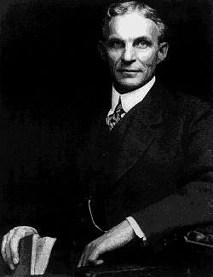
(Q1) Is There One Best Way Of Doing Things?
'To standardise a method is to choose out of many the best one and use it. What is the best way to do a thing? It is the sum of all the good ways we have discovered up to the present. It therefore becomes the standard.
Today’s standardisation is the necessary foundation on which tomorrow’s improvement will be based. If you think of standardisation as ‘the best we know today, but which is to be improved tomorrow’ – you get somewhere. But if you think of standards as confining, the progress stops.'
Henry Ford (1863 – 1947)
Notes:
Founder of the Ford Motor Company, and the sponsor of the development of the assembly line technique of mass production.
Although Ford did not invent the automobile or the assembly line,[1] he developed and manufactured the first automobile that many middle class Americans could afford.
In doing so, Ford converted the automobile from an expensive curiosity into a practical conveyance.

Slide 4
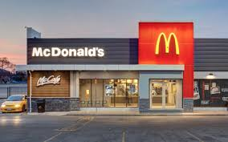
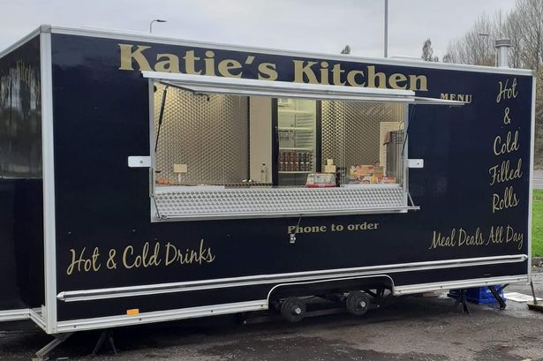
(Q1) Standardised Work
Restaurant Chain
Snack Van
Quick service
Known Menu
Set Prices
Same Quality
Don’t know how long….
Varying Menu
Varying Prices
Unsure of Quality
Notes:
What would happen without standards?
Examples:
We don’t know why things go wrong (or right!)
No control
Not safe
Inconsistent quality
Unpredictable delivery performance
Can’t train people consistently

Slide 5
(Q2) How can standardisation improve a business and make it become more competitive
Improve clarity of activity
Promote best practice
Guarantee quality
Increase productivity
Promote efficacy
Manage time
Reduce cost
Reduce risk and improve safety
Reduces waste
Boosts employee morale
Improves customer service
Incorporating standard operating procedures
Notes:
Other points to consider:
Standard work supports stability and reduces variation because the work is performed the same way each time. Variations (defects, deviations, discrepancies) are easily recognised
Standard work is not static, and when a better way is found the procedure is updated through a managed process
Standardisation allows you to ‘hold the gains’ rather than slip back to old ways, by ensuring that the improved method is captured and form the new baseline
Standard work is essential for continuous improvement – moving from one standard to a better standard without slipping back

Slide 6
(Q3) What are Standard Operating Procedures? (SOP)
Standard Operating Procedures (SOP) are both a set of written instructions and a written record of procedure. SOPs aim to ensure that regularly performed tasks are completed consistently and uniformly across organisations and can be effective measures to improve performance.

Slide 7
(Q3) What are the Benefits of SOP?
Reduce employee training time
Reduce errors and enhance productivity
Establish a chain of command
Maintain consistency
Transfer work easily
Meet legal requirements

Slide 8
(Q4) The Function of a Standard Operating Procedure
Records all standard operating criteria.
Presents the information in a structured chronological order
Provides all information to perform a specific task.
Highlights key points i.e. Safety, Quality, Cost and Delivery
A live document
Notes:
A SOP is not there to fall back on, the operator should not have their own way. SOP’s must be followed to ensure ‘First Time Through’ (FTT).

Slide 9
(Q5) Key Points that are Included on a Standard Operation Sheet
Main Steps
Operations
Plan and gather information
Work out your purpose
What are you looking to achieve?
What are your pain points?
Who is involved?
Work out all the necessary steps of the process
Risk assessment on your process
Test the process
Run the process
Review the process
Refine the process
Risk assess

Slide 10
(Q6) Value Added and Non-Value Added Activities
Value added
Non-value added
Modification
Value for money
First time charm
Assembly
Service provision
Meeting customer requirements
Repair activities
Overproduction
Over-processing
Waiting Time/idling
Process steps which are not needed
Government regulation

Slide 11
(Q7) Principles of Motion Economy
The principles of motion economy can be classified into four groups:
Principles related to the use of human body
Principles related to the arrangement of the work place
Principles related to the design of tools and equipment
Principles related to time conservation
Notes:
Refer to the VLE for breakdown and more information for each principle.

Slide 12
(Q8 & 9) SOP - Collect, Use, & Review Information
Discussion: Consider these below points
What information do you need to write a SOP?
Who is involved in collecting the information?
Who will carry out the SOP?
When will the SOP be implemented ?
How will SOP be implemented ?

Slide 13
Useful links
https://www.process.st/process-standardization/
http://www.novatekcom.com/blog/bid/377591/developing-effective-standard-operating-procedures
https://www.process.st/writing-standard-operating-procedures/
https://blog.montrium.com/experts/5-fundamental-steps-to-creating-powerful-standard-operating-procedures
www.beyondlean.com/support-files/standard-operations.pdf · PDF file
https://marekonlean.files.wordpress.com/2012/02/twi-job-instruction
https://www.graphicproducts.com/articles/value-added-vs-non-value
https://www.sixsigmadaily.com/what-is-value-add-vs-non-value-ad

